Slide 1

NOTION
CONTENT · PROJECTS · DATA
COURSE SLIDES · WSQ
Mastering Notion for Content, Project, and Database Management
WSQ Course Code: TGS-2023041080 · 2-Day Hands-On Training (14 h training + 2 h assessment)
Skills Framework TSC: Content Management (ICT-SNM-3026-1.1)
Conducted by Tertiary Infotech Academy Pte Ltd · UEN 201200696W
Version v6 · 5 September 2026
© 2026 Tertiary Infotech Academy Pte Ltd. All rights reserved. · www.tertiarycourses.com.sg

Slide 2
COURSE ADMINISTRATION
Welcome & Housekeeping
Mastering Notion for Content, Project, and Database Management · TGS-2023041080
© 2026 Tertiary Infotech Academy Pte Ltd
2

Slide 3
TRAQOM · SSG DIGITAL ATTENDANCE
Digital Attendance (Mandatory)
1
2
3
4
Trainer displays the SSG digital attendance QR code
Scan it with your phone camera (Singpass app)
Submit your attendance
Repeat for AM, PM and the assessment session
Attendance is taken digitally for every session of a WSQ-funded course; a minimum of 75% attendance is required for assessment and funding.
Mastering Notion for Content, Project, and Database Management · TGS-2023041080
© 2026 Tertiary Infotech Academy Pte Ltd
3

Slide 4
YOUR TRAINER · GENERAL
About the Trainer
NAME
____________________________________________
?
TITLE / DESIGNATION
____________________________________________
QUALIFICATIONS
____________________________________________
Your Trainer
AREAS OF EXPERTISE
____________________________________________
General Trainer template —
to be completed by the trainer
TRAINING & INDUSTRY EXPERIENCE
____________________________________________
CONTACT
____________________________________________
Mastering Notion for Content, Project, and Database Management · TGS-2023041080
© 2026 Tertiary Infotech Academy Pte Ltd
4

Slide 5
YOUR TRAINER
About the Trainer
ROLE
Principal Trainer, Tertiary Infotech Academy Pte Ltd
AA
BACKGROUND
PhD — 20+ years of industry and training experience in software, data, AI and digital productivity tools.
Dr. Alfred Ang
DELIVERS
WSQ courses on Notion, Microsoft 365 and Copilot, data analytics, AI and web technologies.
Principal Trainer
Tertiary Infotech Academy Pte Ltd
FOUNDER
Founder and lead instructor at Tertiary Infotech / Tertiary Courses.
Mastering Notion for Content, Project, and Database Management · TGS-2023041080
© 2026 Tertiary Infotech Academy Pte Ltd
5

Slide 6
ICE-BREAKER
Let's Know Each Other
Who you are
Your name, your organisation and your role in it.
Your content today
Where your team's documents, projects and data live right now.
1
2
Your Notion experience
Never used it, personal use, or already running a team workspace?
What you want to build
One thing you would like to manage in Notion by the end of Day 2.
3
4
Mastering Notion for Content, Project, and Database Management · TGS-2023041080
© 2026 Tertiary Infotech Academy Pte Ltd
6

Slide 7
HOUSEKEEPING
Ground Rules
Set your mobile phone to silent mode.
Participate actively — no question is too small.
1
2
Respect each other's views; one conversation at a time.
Step out quietly for calls or breaks.
3
4
Be punctual; return from breaks on time.
75% attendance is required for assessment and funding.
5
6
Mastering Notion for Content, Project, and Database Management · TGS-2023041080
© 2026 Tertiary Infotech Academy Pte Ltd
7

Slide 8
COURSE PORTAL · LMS/TMS
Download Course Material
https://lms-tms.tertiaryinfotech.com
Sign in
lms-tms.tertiaryinfotech.com — log in with your registered email (OTP or password).
1
Tertiary Infotech LMS/TMS
My Courses · Attendance · Assessment
Open your course
Select 'Mastering Notion for Content, Project, and Database Management' under My Courses.
2
Mastering Notion for Content, Project, and Database Management
Trainer Slides (PDF) ⬇
Download materials
Slides, the Learner Guide and the lab folders — your open-book references for the assessment.
3
Learner Guide (PDF) ⬇
Activities / Labs (folder) ⬇
Submit and survey
Upload your assessment answers and complete the TRAQOM survey QR here.
Assessment Submission ↗
4
All course material is downloaded from the LMS/TMS portal — keep it handy: the final assessment is open book.
Mastering Notion for Content, Project, and Database Management · TGS-2023041080
© 2026 Tertiary Infotech Academy Pte Ltd
8

Slide 9
LAB FILES · GITHUB REPOSITORY
Access the Hands-On Labs
Repository: https://github.com/tertiarycourses/TGS-2023041080-Mastering-Notion-for-Content-Project-and-Database-Management
Option A — Clone
Option B — Download ZIP
What each lab folder holds
• Install Git, then in a terminal run:
• git clone https://github.com/tertiarycourses/TGS-2023041080-Mastering-Notion-for-Content-Project-and-Database-Management.git
• Open the labs/ folder — one sub-folder per lab.
• On GitHub click Code → Download ZIP.
• Unzip anywhere on your laptop.
• Open labs/ — no tools to install.
• README.md — brief, procedure, acceptance test
• lab.yaml — metadata, K/A codes, files
• Mock data: CSV, Markdown, JSON, images
• LAB-NN-Instructions.pdf + workflow PNG
12 labs · all run in Notion in your browser on a free account · the same folders are on the LMS under Activities
Mastering Notion for Content, Project, and Database Management · TGS-2023041080
© 2026 Tertiary Infotech Academy Pte Ltd
9

Slide 10
ONE STORY, TWELVE LABS
The Course Scenario — Brightwave Media
Brightwave Media Pte Ltd
A twelve-person Singapore content and digital-marketing agency.
The move to Notion
Company wiki, content operations, client projects and a public help centre in one workspace.
1
2
Day 1 — build the content system
Workspace, wiki, policies, collaboration and rich, styled content (Labs 1–6).
Day 2 — run it as a CMS
Databases, permissions, publishing, analytics, integrations and Notion AI (Labs 7–12).
3
4
One connected story
Every lab adds to the same workspace, so the final result is a complete, governed CMS.
Mock data supplied
Each lab folder carries the CSV, Markdown, JSON and images the lab needs.
5
6
Mastering Notion for Content, Project, and Database Management · TGS-2023041080
© 2026 Tertiary Infotech Academy Pte Ltd
10

Slide 11
WSQ ALIGNMENT · PART 1
Skills Framework — Content Management
TSC element
Detail
TSC Title / Code
Content Management · ICT-SNM-3026-1.1
Ability A1
Implement content management policies, guidelines and permissions on content management
Ability A2
Post and update content on content management systems
Ability A3
Maintain web properties and assets to uphold standards on user experience
Ability A4
Maintain awareness of market offerings on content management systems
Ability A5
Report on metrics to measure performance of content management systems
Ability A6
Recommend the adoption of appropriate plug-ins to manage and maintain the organisation's web properties and assets
Ability A7
Generate ideas to improve customer and visitor experience on web properties and assets
Knowledge K1
Content management policies, guidelines and permissions on content management
Knowledge K2
Web content for deployment
Knowledge K3
Organisation's web properties and assets
Knowledge K4
Creation and curation of web content guidelines
Mastering Notion for Content, Project, and Database Management · TGS-2023041080
© 2026 Tertiary Infotech Academy Pte Ltd
11

Slide 12
WSQ ALIGNMENT · PART 2
Skills Framework — Knowledge Statements
Code
Knowledge statement
Taught in
K1
Content management policies, guidelines and permissions on content management
Topics 1–2 · Lab 2
K2
Web content for deployment
Topic 3 · Labs 4–5
K3
Organisation's web properties and assets
Topic 5 · Labs 7–8
K4
Creation and curation of web content guidelines
Topic 4 · Lab 6
K5
Web content and platform management systems
Topic 2 · Lab 3
K6
Types of performance metrics of content management systems
Topic 7 · Lab 10
K7
Customer and visitor experience on web properties and assets
Topic 6 · Lab 9
K8
Types of market offerings on content management systems
Topics 6, 9 · Lab 12
K9
Types of plug-ins to manage the organisation's web properties and assets
Topic 8 · Lab 11
Mastering Notion for Content, Project, and Database Management · TGS-2023041080
© 2026 Tertiary Infotech Academy Pte Ltd
12

Slide 13
BY THE END OF THIS COURSE
Learning Outcomes
1
LO1
Implement content management policies on Notion adhering to organizational guidelines and permissions
2
LO2
Post and update content on Notion, ensuring adherence to content creation and curation guidelines
3
LO3
Maintain web properties and assets in Notion, while staying aware of market offerings
4
LO4
Report on performance metrics, recommend appropriate plug-ins, and generate ideas to enhance customer and visitor experiences on Notion
Mastering Notion for Content, Project, and Database Management · TGS-2023041080
© 2026 Tertiary Infotech Academy Pte Ltd
13

Slide 14
THE JOURNEY
Course Outline — Four Learning Units, Nine Topics
1
LU1 · Foundations and Workspace Management
Topic 1 Introduction to Notion · Topic 2 Workspace Collaboration Tools — Labs 1–3 (LO1)
2
LU2 · Content Creation and Management
Topic 3 Pages and Content Blocks · Topic 4 Advanced Content Techniques — Labs 4–6 (LO2)
3
LU3 · Mastering Databases in Notion
Topic 5 Database Essentials · Topic 6 Advanced Database Features — Labs 7–9 (LO3)
4
LU4 · Collaboration, Publishing and Integrations
Topic 7 Collaboration and Publishing · Topic 8 Data Management and Integrations · Topic 9 Notion AI — Labs 10–12 (LO4)
Mastering Notion for Content, Project, and Database Management · TGS-2023041080
© 2026 Tertiary Infotech Academy Pte Ltd
14

Slide 15
SCHEDULE
Lesson Plan — 2 Days, 9:30am–6:30pm
Day 1
Day 2
• Day 1 — Foundations and content (8 h)
– AM attendance · introductions · learning outcomes
– Topic 1 Introduction to Notion · Labs 1–2
– Topic 2 Workspace Collaboration Tools · Lab 3
– Lunch (1 hour)
– PM attendance · Topic 3 Pages and Content Blocks · Labs 4–5
– Topic 4 Advanced Content Techniques · Lab 6
– Day 1 recap and Q&A
• Day 2 — Databases, publishing, AI (6 h + 2 h assessment)
– AM attendance · Topic 5 Database Essentials · Labs 7–8
– Topic 6 Advanced Database Features · Lab 9
– Lunch (1 hour)
– PM attendance · Topic 7 Collaboration and Publishing · Lab 10
– Topic 8 Data Management and Integrations · Lab 11
– Topic 9 Notion AI · Lab 12 · briefing for assessment
– 4:30pm WA (SAQ) 1 h · 5:30pm PP 1 h · TRAQOM
RULE 14 training hours + 2 assessment hours · 10-minute tea breaks are within training time · full timings in the Lesson Plan.
Mastering Notion for Content, Project, and Database Management · TGS-2023041080
© 2026 Tertiary Infotech Academy Pte Ltd
15

Slide 16
BEFORE ASSESSMENT
Briefing for Assessment
Phones away
Place phones and other materials under the table or on the floor.
No recording
No photos or recording of assessment scripts, at any point.
1
2
No discussion
Work individually — no discussion once the assessment starts.
Black or blue pen
Use a black or blue pen for any hard-copy assessment.
3
4
No correction fluid
No liquid paper or correction tape; strike through instead.
Time is called
Scripts are collected when time is up — submit on the LMS before then.
5
6
Mastering Notion for Content, Project, and Database Management · TGS-2023041080
© 2026 Tertiary Infotech Academy Pte Ltd
16

Slide 17
FINAL ASSESSMENT
Final Assessment
Written Assessment (WA)
Practical Performance (PP)
Format
Short-answer questions (SAQ)
Scenario-based practical tasks in Notion
What it tests
Underpinning knowledge K1–K9
Practical abilities A1–A7
Items
9 questions
5 tasks
Duration
1 hour
1 hour
Conditions
Open book, individual
Open book, individual
Submission
On the LMS
On the LMS, with screenshots as evidence
RULE Open book: slides, Learner Guide and your own lab work. 75% attendance is required; an appeal process is available.
Mastering Notion for Content, Project, and Database Management · TGS-2023041080
© 2026 Tertiary Infotech Academy Pte Ltd
17

Slide 18
ON ASSESSMENT DAY
Assessment Flow
1
2
3
4
5
TRAQOM survey — scan the QR code on the LMS
Assessment digital attendance — scan the SSG QR
Sit WA (SAQ) then PP — open book
Submit your answers on the LMS
Sign the Assessment Summary Record
The TRAQOM QR code and the assessment submission are both on the LMS — https://lms-tms.tertiaryinfotech.com
Mastering Notion for Content, Project, and Database Management · TGS-2023041080
© 2026 Tertiary Infotech Academy Pte Ltd
18

Slide 19
01
TOPIC 01 · LU1 · A1 · K1
Introduction to Notion
Overview of Notion · what is a block · first page and subpage · workspace and sidebar · navigating and customising · wikis and verified pages
Mastering Notion for Content, Project, and Database Management · TGS-2023041080
© 2026 Tertiary Infotech Academy Pte Ltd
19

Slide 20
TOPIC 01 · WHAT THIS TOPIC COVERS
Key Concepts — Introduction to Notion
One connected workspace
Notion combines documents, wikis, project trackers and databases in one tool, so content, projects and data live together instead of across five apps.
Everything is a block
Text, headings, images, tables, embeds and even databases are blocks. Blocks can be transformed into other types and rearranged by dragging.
1
2
Pages nest inside pages
A page holds blocks and sub-pages, giving an unlimited hierarchy. Breadcrumbs and the sidebar show where you are.
The workspace and sidebar
The sidebar is the map: Teamspaces for shared work, Private for your own pages, Shared for pages shared with you, plus Favorites, Templates, Import and Trash.
3
4
Workspaces are separate
Each workspace has its own members, plan and content. Switch or add another account from the workspace switcher; move top-level pages to migrate content.
Wikis and verified pages
Turn a teamspace page into a wiki to add owners, verification and expiry, so the organisation knows which content is authoritative and current.
5
6
Mastering Notion for Content, Project, and Database Management · TGS-2023041080
© 2026 Tertiary Infotech Academy Pte Ltd
20

Slide 21
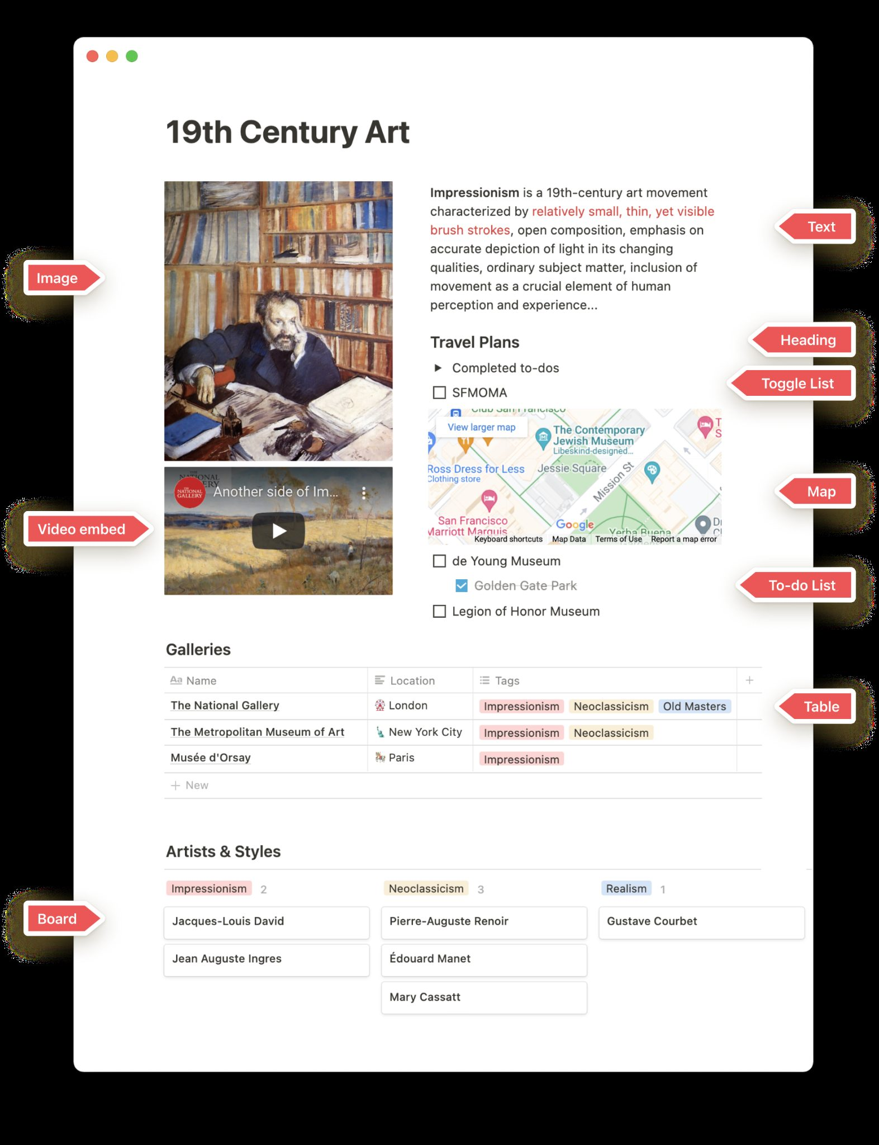
THE BUILDING BLOCK
Everything in Notion Is a Block
1
A page is a stack of blocks
Text, headings, lists, images, tables, embeds and databases are all blocks with the same handle.
2
Blocks transform
⋮⋮ → Turn into converts a paragraph to a heading, a bullet to a toggle, a list to a page — content stays.
3
Blocks rearrange
Drag by the ⋮⋮ handle; drop beside another block to create columns, drop below to reorder.
4
Slash opens the menu
Type / on any line to see every block: basic, inline, database, media, embed, advanced.
Mastering Notion for Content, Project, and Database Management · TGS-2023041080
© 2026 Tertiary Infotech Academy Pte Ltd
21

Slide 22
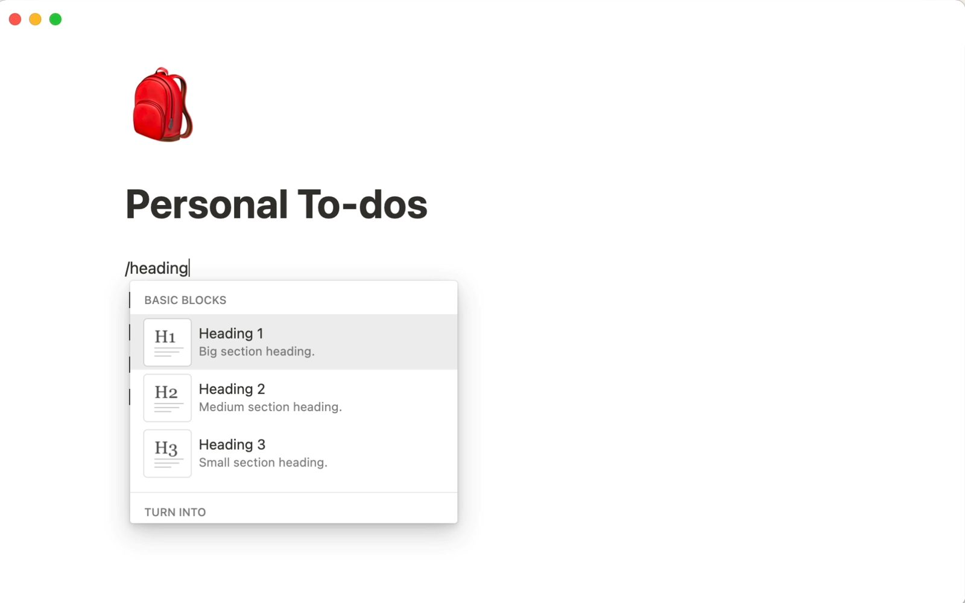
WRITE FAST
Slash Commands and Markdown Shortcuts
1
/ for blocks
/h1, /todo, /callout, /table, /image, /code, /page — type the name to filter the menu.
2
Markdown on the fly
# heading, - bullet, [] to-do, > toggle, ``` code, --- divider, ** bold, ` inline code.
3
@ and [[
@ mentions people, pages and dates; [[ links or creates a page; + creates a page elsewhere.
4
Keyboard first
Cmd/Ctrl+N new page, Cmd/Ctrl+Shift+N new window, Cmd/Ctrl+P quick find, Cmd/Ctrl+Shift+0-9 block types.
Mastering Notion for Content, Project, and Database Management · TGS-2023041080
© 2026 Tertiary Infotech Academy Pte Ltd
22

Slide 23
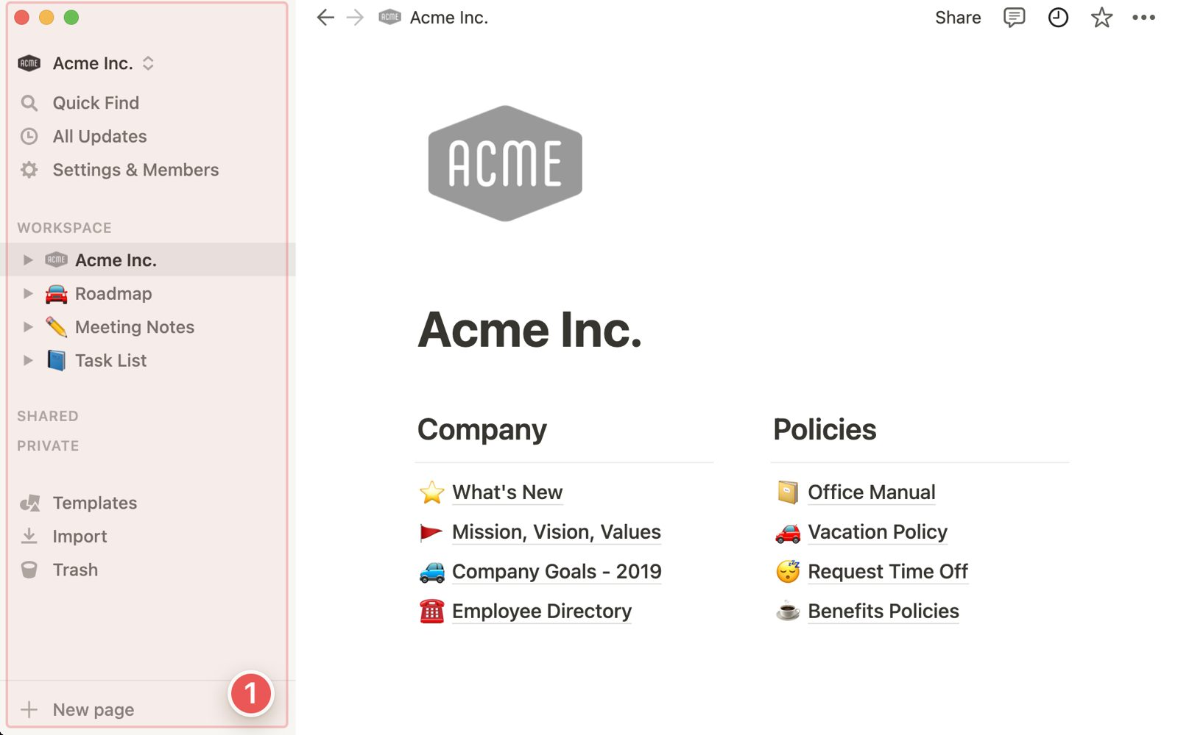
NAVIGATE
The Sidebar Is the Map of Your Workspace
1
Teamspaces
Shared areas with owners and members — the default home for organisational content.
2
Private and Shared
Private pages only you see; Shared appears when a page is shared with selected people.
3
Favorites, Templates, Import, Trash
Pin frequent pages; start from templates; import from other tools; restore deleted pages.
4
Breadcrumbs and hover options
The top bar shows the path; hovering a sidebar page reveals ⋯ (options) and + (new sub-page).
Mastering Notion for Content, Project, and Database Management · TGS-2023041080
© 2026 Tertiary Infotech Academy Pte Ltd
23

Slide 24
THREE LEVELS OF ORGANISATION
Workspaces, Teamspaces and Pages
Level
What it is
Who controls it
Brightwave example
Workspace
The whole account for an organisation — members, plan, settings
Workspace owners
Brightwave Media
Teamspace
A section with its own members and default permissions
Teamspace owners
Client Work (closed), Company (open)
Page
Content built from blocks; nests without limit
Page owner / editors
Company Wiki → Policies → Naming Conventions
Database
A page whose children are structured rows
Editors with 'can edit content'
Content Calendar, Tasks, Clients
RULE Keep the number of workspaces to a minimum — content cannot be linked across workspaces, but it can be moved between them.
Mastering Notion for Content, Project, and Database Management · TGS-2023041080
© 2026 Tertiary Infotech Academy Pte Ltd
24

Slide 25
FROM BLANK TO HIERARCHY
Create Your First Page and Sub-page
1
New page
2
Write blocks
3
Add a sub-page
4
Navigate
5
Organise
+ New page in the sidebar or Cmd/Ctrl+N; add an icon and cover
Type text, press / for other block types, drag to rearrange
/page inside the body, or + next to the page in the sidebar
Breadcrumbs go up; sidebar toggles reveal nesting
Favorite, move, duplicate or delete pages from ⋯
WHY IT MATTERS The hierarchy IS the information architecture: decide the four top-level sections before anyone writes a page.
Mastering Notion for Content, Project, and Database Management · TGS-2023041080
© 2026 Tertiary Infotech Academy Pte Ltd
25

Slide 26
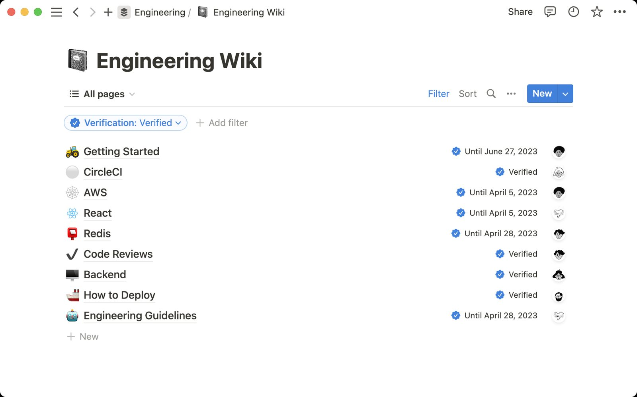
TRUSTED CONTENT
Wikis and Verified Pages
1
Turn into wiki
Any teamspace page becomes a wiki with Owner, Verification and Last edited on every page.
2
Owners are accountable
One named owner per page — the policy rule that makes content management auditable.
3
Verify with expiry
Verified pages carry a badge and an expiry (e.g. 90 days); the owner is reminded to re-review.
4
Views of the wiki
Table, board or list views of all pages, grouped by owner or verification status, expose stale content.
Mastering Notion for Content, Project, and Database Management · TGS-2023041080
© 2026 Tertiary Infotech Academy Pte Ltd
26

Slide 27
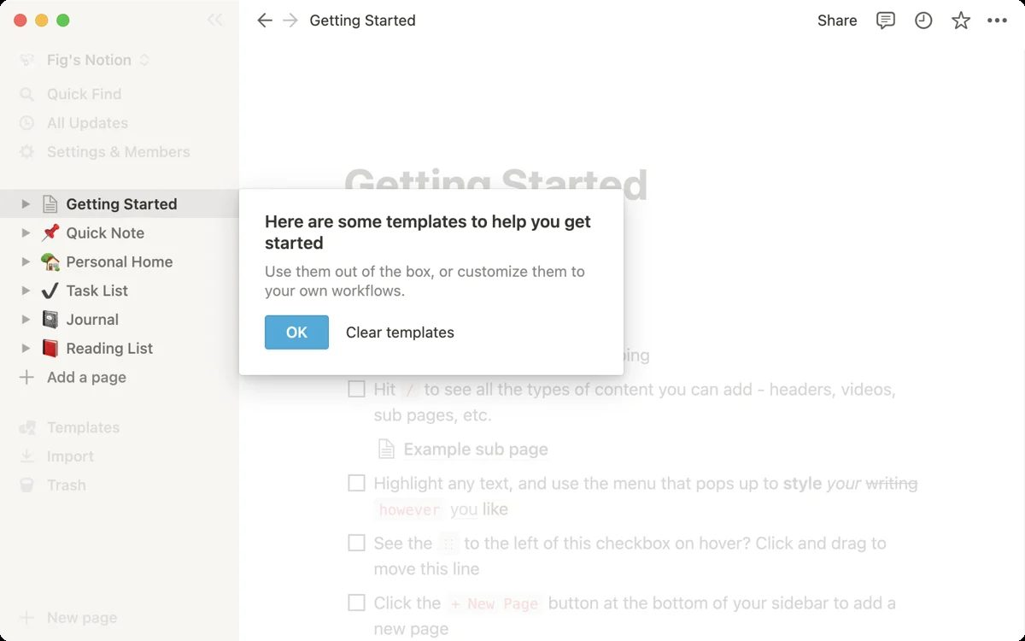
MARKET OFFERINGS
Start with Templates — or Build Your Own
1
10,000+ templates
The template gallery covers wikis, project trackers, CRMs, docs and personal use.
2
In-app templates
New page → Templates shows starter templates for the page type you need.
3
Duplicate community pages
Public pages can be duplicated into your workspace when the author allows it.
4
Policy check
Brightwave allows approved templates only — customise once, then reuse.
Mastering Notion for Content, Project, and Database Management · TGS-2023041080
© 2026 Tertiary Infotech Academy Pte Ltd
27

Slide 28
TOPIC 01 · HANDS-ON LAB · FOUNDATION
Set Up the Brightwave Workspace, Pages and Blocks
LAB 01
K1 · A1
30 min
You create the Brightwave Media workspace, build the top-level page structure from the supplied site map, and learn how blocks, slash commands, sub-pages, breadcrumbs and the sidebar work by building the Company Home page.
You will build
A Brightwave workspace with a Company Home page, four top-level section pages and a working sub-page hierarchy
Tools: Notion (web or desktop app)
ASSESSED K1 · A1
LEVEL Foundation
EVIDENCE Screenshots · lab README checklist
Mastering Notion for Content, Project, and Database Management · TGS-2023041080
© 2026 Tertiary Infotech Academy Pte Ltd
28

Slide 29
LAB 01 · WORKFLOW
How Lab 01 Runs
1
Prepare
2
Build
3
Refine
4
Verify
Create the workspace
Build pages from the site map
Add and transform blocks
Organise the sidebar
WHY IT MATTERS The shape of the work — the full click-by-click procedure is in the Learner Guide (Lab 01) and the lab's instruction PDF.
Mastering Notion for Content, Project, and Database Management · TGS-2023041080
© 2026 Tertiary Infotech Academy Pte Ltd
29

Slide 30
LAB 01 · ACCEPTANCE CHECK
Set Up the Brightwave Workspace, Pages and Blocks
✅ Acceptance check
The sidebar shows Company Home in Favorites with the four section pages nested under it, each section contains the sub-pages listed in workspace-structure.csv, and Company Home carries an icon, a cover, a heading, a callout and a toggle list.
IF IT DOES NOT WORK
1
Re-read the step: most misses are the page menu (top right) versus the block handle (left of a block).
2
Check you are in the right page or teamspace — the sidebar shows the path.
3
Full click-by-click steps: Learner Guide and the lab's instruction PDF.
Mastering Notion for Content, Project, and Database Management · TGS-2023041080
© 2026 Tertiary Infotech Academy Pte Ltd
30

Slide 31
TOPIC 01 · HANDS-ON LAB · FOUNDATION
Build the Company Wiki with Verified Pages and a Content Policy
LAB 02
K1 · A1
35 min
You turn the Company Wiki into a Notion wiki, import the supplied policy documents, assign page owners, verify the authoritative pages with an expiry date, and publish the content management policy that governs the rest of the workspace.
You will build
A Notion wiki with imported policy pages, named owners, verified status and a visible content management policy
Tools: Notion, Markdown import
ASSESSED K1 · A1
LEVEL Foundation
EVIDENCE Screenshots · lab README checklist
Mastering Notion for Content, Project, and Database Management · TGS-2023041080
© 2026 Tertiary Infotech Academy Pte Ltd
31

Slide 32
LAB 02 · WORKFLOW
How Lab 02 Runs
1
Prepare
2
Build
3
Refine
4
Verify
Turn the page into a wiki
Import the policy documents
Assign owners and verify
Publish the policy notice
WHY IT MATTERS The shape of the work — the full click-by-click procedure is in the Learner Guide (Lab 02) and the lab's instruction PDF.
Mastering Notion for Content, Project, and Database Management · TGS-2023041080
© 2026 Tertiary Infotech Academy Pte Ltd
32

Slide 33
LAB 02 · ACCEPTANCE CHECK
Build the Company Wiki with Verified Pages and a Content Policy
✅ Acceptance check
Company Wiki shows the wiki header, three pages carry the green Verified badge with a 90-day expiry, every page has an owner matching page-owner-register.csv, the Verification view lists only unverified pages, and Company Home links to the policy.
IF IT DOES NOT WORK
1
Re-read the step: most misses are the page menu (top right) versus the block handle (left of a block).
2
Check you are in the right page or teamspace — the sidebar shows the path.
3
Full click-by-click steps: Learner Guide and the lab's instruction PDF.
Mastering Notion for Content, Project, and Database Management · TGS-2023041080
© 2026 Tertiary Infotech Academy Pte Ltd
33

Slide 34
02
TOPIC 02 · LU1 · A1 · K5
Workspace Collaboration Tools
Collaborate within a workspace · comments, mentions and reminders · updates and notifications · search
Mastering Notion for Content, Project, and Database Management · TGS-2023041080
© 2026 Tertiary Infotech Academy Pte Ltd
34

Slide 35
TOPIC 02 · WHAT THIS TOPIC COVERS
Key Concepts — Workspace Collaboration Tools
Real-time co-editing
Several people edit the same page at once; avatars show who is where, and page history lets you restore an earlier version.
Comments and discussions
Top-level page discussions and inline comments keep feedback next to the content; resolve, react to or reopen threads.
1
2
@-mentions
Type @ to mention a person, a page or a date. A mentioned person is notified; a mentioned page becomes a link and a backlink.
Reminders
Any date mention can carry a reminder, so a review date notifies the owner on the day, in the app and by email or push.
3
4
Updates and notifications
The Inbox (Updates) collects mentions, comments and page changes across the workspace; tune email and mobile notifications in Settings.
Search that understands structure
Quick Find searches titles and content; filter by teamspace, creator, date or page, sort results and search inside a database.
5
6
Mastering Notion for Content, Project, and Database Management · TGS-2023041080
© 2026 Tertiary Infotech Academy Pte Ltd
35

Slide 36
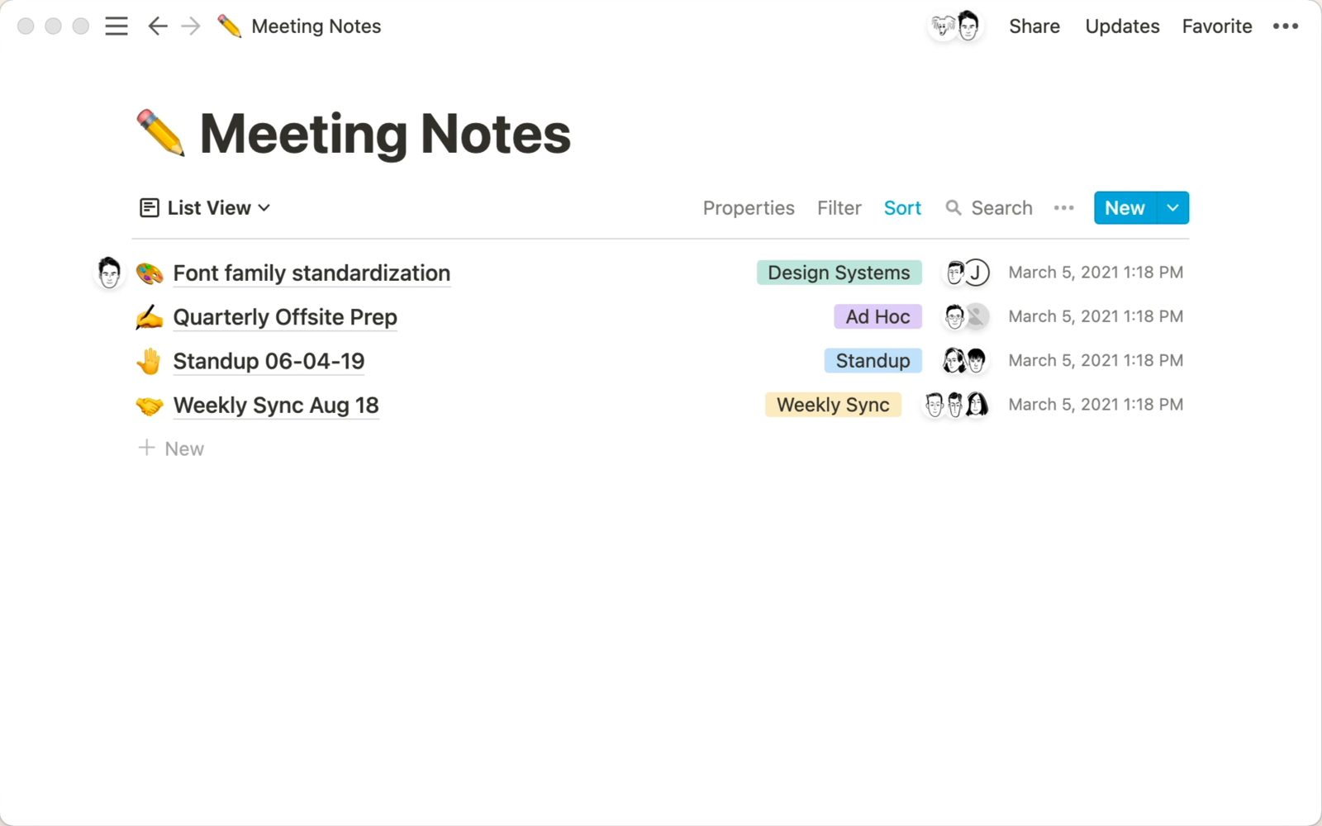
COLLABORATE
Work Together in Real Time
1
Live cursors and avatars
Everyone with edit access can type at once; avatars show who is on the page.
2
Page history
⋯ → Page history restores earlier snapshots (7 days Free, 30 Plus, 90 Business, unlimited Enterprise).
3
Comments live with content
Inline comments attach to a sentence; page discussions sit under the title.
4
Page lock
Lock a finished page so casual edits are blocked while comments stay open.
Mastering Notion for Content, Project, and Database Management · TGS-2023041080
© 2026 Tertiary Infotech Academy Pte Ltd
36

Slide 37
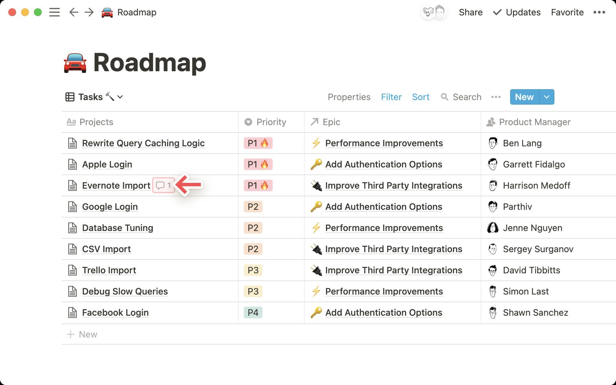
FEEDBACK IN CONTEXT
Comments, Mentions and Reminders
1
Comment on anything
Highlight → Comment, or the comment icon on images, files and database properties.
2
@-mention people, pages, dates
A mentioned person is notified; a mentioned page links both ways; a date can remind.
3
Resolve, react, reopen
Resolved threads disappear from the page but stay in the comments sidebar.
4
Reminders
Set on any date mention — at time of event, 5 minutes, 1 hour, 1 day or 2 days before.
Mastering Notion for Content, Project, and Database Management · TGS-2023041080
© 2026 Tertiary Infotech Academy Pte Ltd
37

Slide 38
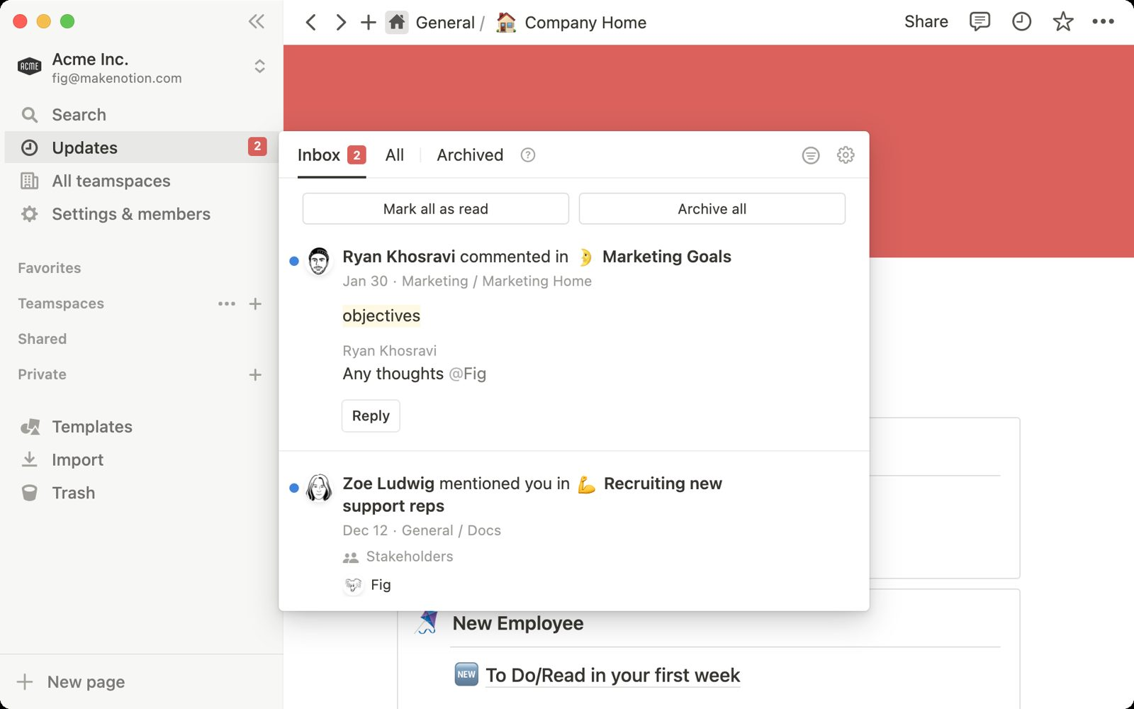
NEVER MISS A CHANGE
Updates and Notifications
1
Inbox
Mentions, comments, page invitations and database notifications in one list.
2
All updates
Every change on pages you follow, grouped by page — turn Follow on or off per page.
3
Email and mobile
Settings → Notifications: mentions always, page activity, workspace digest, mobile push.
4
Slack too
Connect Slack to receive @-mentions and database notifications in a channel.
Mastering Notion for Content, Project, and Database Management · TGS-2023041080
© 2026 Tertiary Infotech Academy Pte Ltd
38

Slide 39
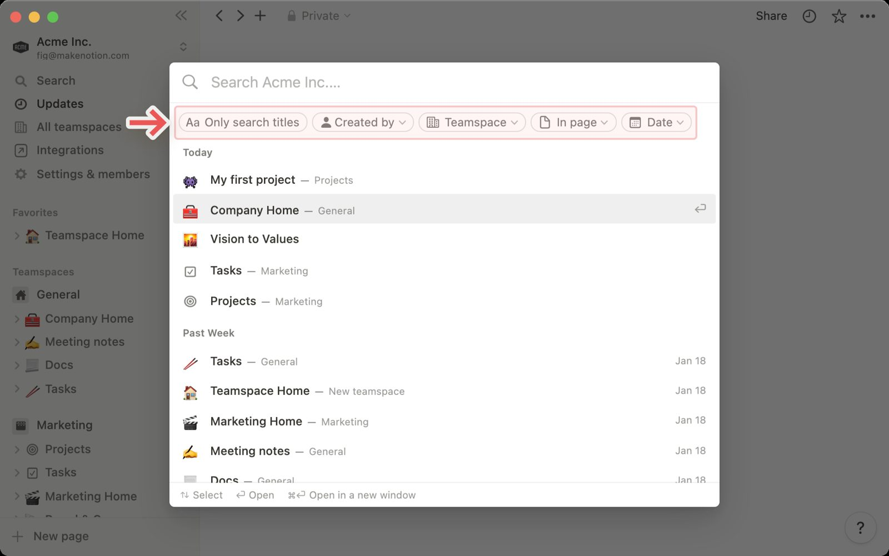
FIND ANYTHING
Search Across the Workspace
1
Quick Find
Cmd/Ctrl+P or the Search button; type to search titles and full text.
2
Filters
Only match titles, Created by, Edited by, In (teamspace or page), Date created or edited.
3
Sort and history
Sort by relevance, last edited or created; recent pages and recent searches appear first.
4
Database search
Inside any database use the search icon to match property values and content.
Mastering Notion for Content, Project, and Database Management · TGS-2023041080
© 2026 Tertiary Infotech Academy Pte Ltd
39

Slide 40
THE COLLABORATION LOOP
A Content Review Round in Notion
1
2
3
4
5
Author shares the page and posts a discussion 'Review round 1'
Reviewer raises inline comments and @-mentions owners
Owners fix the text, reply and resolve each thread
Reminder dates chase anything still open
Inbox and page history confirm every change
Comments are the audit trail of content decisions — resolve, do not delete.
Mastering Notion for Content, Project, and Database Management · TGS-2023041080
© 2026 Tertiary Infotech Academy Pte Ltd
40

Slide 41
CHOOSE THE RIGHT TOOL
Collaboration Tools — When to Use Which
Need
Use
Who sees it
Leaves a trace?
Ask a question about one sentence
Inline comment
Everyone on the page
Yes — comment thread
Alert a colleague
@-mention
The person (Inbox + email)
Yes — in the comment or text
Chase a deadline
Date mention + reminder
The mentioned person
Yes — the date chip
Discuss the page overall
Page discussion
Everyone on the page
Yes — under the title
Track a change
Page history
Editors
Yes — snapshots
Find related work
Search filters
You
No
RULE Prefer comments to chat messages: the decision stays next to the content it changed.
Mastering Notion for Content, Project, and Database Management · TGS-2023041080
© 2026 Tertiary Infotech Academy Pte Ltd
41

Slide 42
TOPIC 02 · HANDS-ON LAB · INTERMEDIATE
Run a Content Review with Comments, Mentions, Reminders and Search
LAB 03
K5 · A1
35 min
Acting as the reviewer of the About Brightwave page, you raise the feedback items from the supplied review sheet as comments, mention the owners, set dated reminders, resolve threads, watch the Inbox, and use Search filters to find every page that mentions a client.
You will build
A reviewed page with a comment thread per feedback item, mentions and reminders assigned, resolved threads, and a saved search routine
Tools: Notion comments, mentions, reminders, Inbox, Search
ASSESSED K5 · A1
LEVEL Intermediate
EVIDENCE Screenshots · lab README checklist
Mastering Notion for Content, Project, and Database Management · TGS-2023041080
© 2026 Tertiary Infotech Academy Pte Ltd
42

Slide 43
LAB 03 · WORKFLOW
How Lab 03 Runs
1
Prepare
2
Build
3
Refine
4
Verify
Raise inline comments
Mention owners and dates
Set and act on reminders
Search and filter the workspace
WHY IT MATTERS The shape of the work — the full click-by-click procedure is in the Learner Guide (Lab 03) and the lab's instruction PDF.
Mastering Notion for Content, Project, and Database Management · TGS-2023041080
© 2026 Tertiary Infotech Academy Pte Ltd
43

Slide 44
LAB 03 · ACCEPTANCE CHECK
Run a Content Review with Comments, Mentions, Reminders and Search
✅ Acceptance check
About Brightwave shows one resolved and five open inline comments, each with an @-mentioned owner, two comments carry reminder bells, the Inbox lists the mentions, and the Nova Retail search returns the pages that name that client.
IF IT DOES NOT WORK
1
Re-read the step: most misses are the page menu (top right) versus the block handle (left of a block).
2
Check you are in the right page or teamspace — the sidebar shows the path.
3
Full click-by-click steps: Learner Guide and the lab's instruction PDF.
Mastering Notion for Content, Project, and Database Management · TGS-2023041080
© 2026 Tertiary Infotech Academy Pte Ltd
44

Slide 45
Lunch Break
1 hour · back for PM digital attendance

Slide 46
03
TOPIC 03 · LU2 · A2 · K2
Pages and Content Blocks
Writing, editing and customisation · keyboard shortcuts · columns, tables, headings and dividers · images, files and media · code blocks and buttons · synced blocks
Mastering Notion for Content, Project, and Database Management · TGS-2023041080
© 2026 Tertiary Infotech Academy Pte Ltd
46

Slide 47
TOPIC 03 · WHAT THIS TOPIC COVERS
Key Concepts — Pages and Content Blocks
Slash commands create blocks
Type / for every block type: basic (text, headings, lists, toggles, quotes, callouts), database, media, embeds and advanced blocks.
Markdown and shortcuts
Markdown-style shortcuts (#, -, [], >, ```) and keyboard shortcuts (Cmd/Ctrl+B, Cmd/Ctrl+E, Cmd/Ctrl+Shift+0-9) make writing fast.
1
2
Structure with layout blocks
Headings build the table of contents, dividers separate sections, simple tables hold small grids and drag-to-side creates columns.
Media in context
Upload or embed images, files, video, audio, PDFs and web bookmarks; align, resize and caption them where the content needs them.
3
4
Code blocks and buttons
Code blocks add syntax highlighting, wrap and copy; buttons insert blocks, add pages or edit properties in one click.
Synced blocks
Content that must appear in several places (a footer, a policy notice) is written once in a synced block and edited everywhere at once.
5
6
Mastering Notion for Content, Project, and Database Management · TGS-2023041080
© 2026 Tertiary Infotech Academy Pte Ltd
47

Slide 48
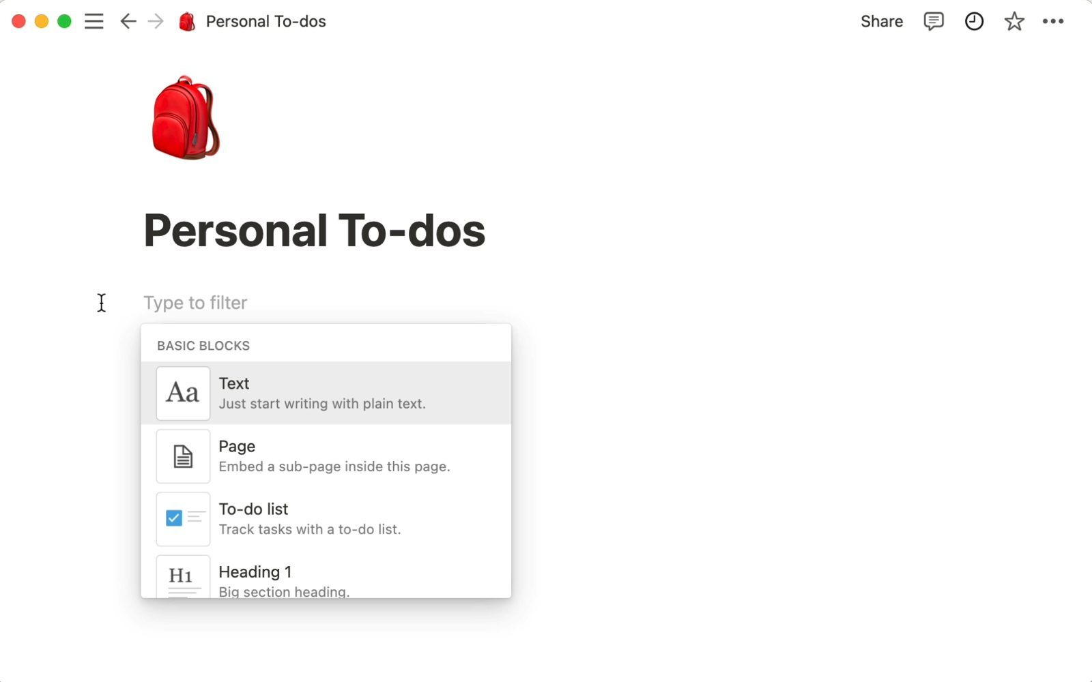
WRITE AND EDIT
Editing Tools and the Block Menu
1
Floating toolbar
Select text: bold, italic, underline, strike, code, link, comment, colour, Ask AI.
2
Block handle ⋮⋮
Delete, Duplicate, Turn into, Move to, Comment, Colour, Copy link to block.
3
Multi-select
Shift+Up/Down or drag to select several blocks; act on them together.
4
Undo everywhere
Cmd/Ctrl+Z reverses edits; Trash and page history recover deletions.
Mastering Notion for Content, Project, and Database Management · TGS-2023041080
© 2026 Tertiary Infotech Academy Pte Ltd
48

Slide 49
THE / MENU
Block Types at a Glance
Group
Blocks
Typical Brightwave use
Basic
Text, headings 1–3, bulleted, numbered, to-do, toggle, quote, divider, callout, link to page
Article body, policies, checklists
Database
Table, board, gallery, list, calendar, timeline — inline or full page
Content calendar, tasks, clients
Media
Image, video, audio, file, code, web bookmark
Hero images, media kit PDF, scripts
Embeds
Google Drive, Maps, Figma, Loom, PDF, Tweet, GitHub gist, Typeform, CodePen, Miro
Design files, recordings, forms
Advanced
Math equation, template button, breadcrumb, table of contents, synced block, toggle heading, columns
Formulas, navigation, brand footer
Inline
Mention person, page or date, emoji, equation
Owners, reminders, cross-links
Mastering Notion for Content, Project, and Database Management · TGS-2023041080
© 2026 Tertiary Infotech Academy Pte Ltd
49

Slide 50
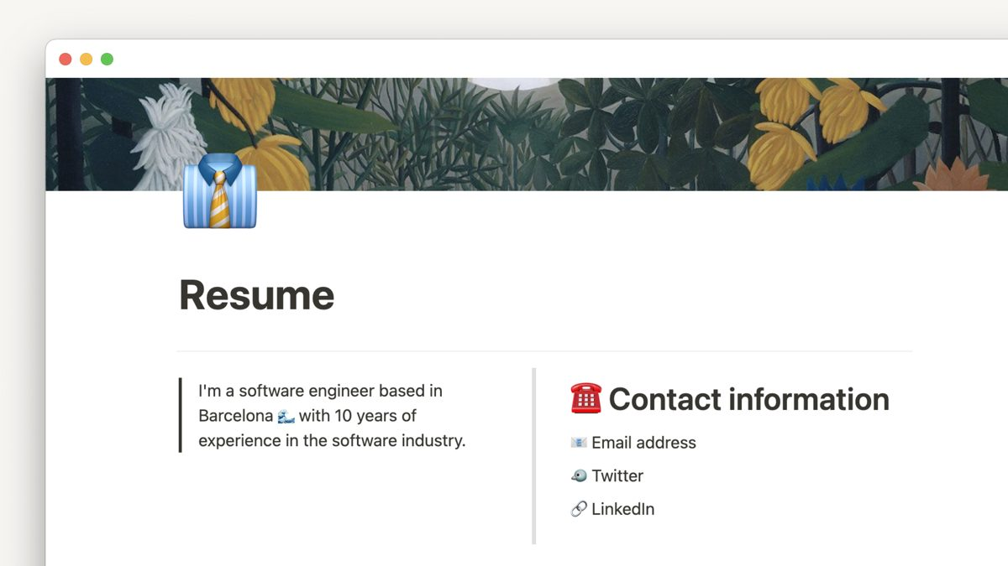
LAYOUT
Columns, Tables, Headings and Dividers
1
Columns by dragging
Drop a block beside another until the blue vertical guide appears; drag the divider to resize.
2
Simple tables
/table gives a lightweight grid with header row and column options — not a database.
3
Headings drive structure
H1 → H2 → H3 build the table of contents; toggle headings collapse whole sections.
4
Dividers and spacing
/divider separates sections; empty blocks add breathing room without styling tricks.
Mastering Notion for Content, Project, and Database Management · TGS-2023041080
© 2026 Tertiary Infotech Academy Pte Ltd
50

Slide 51
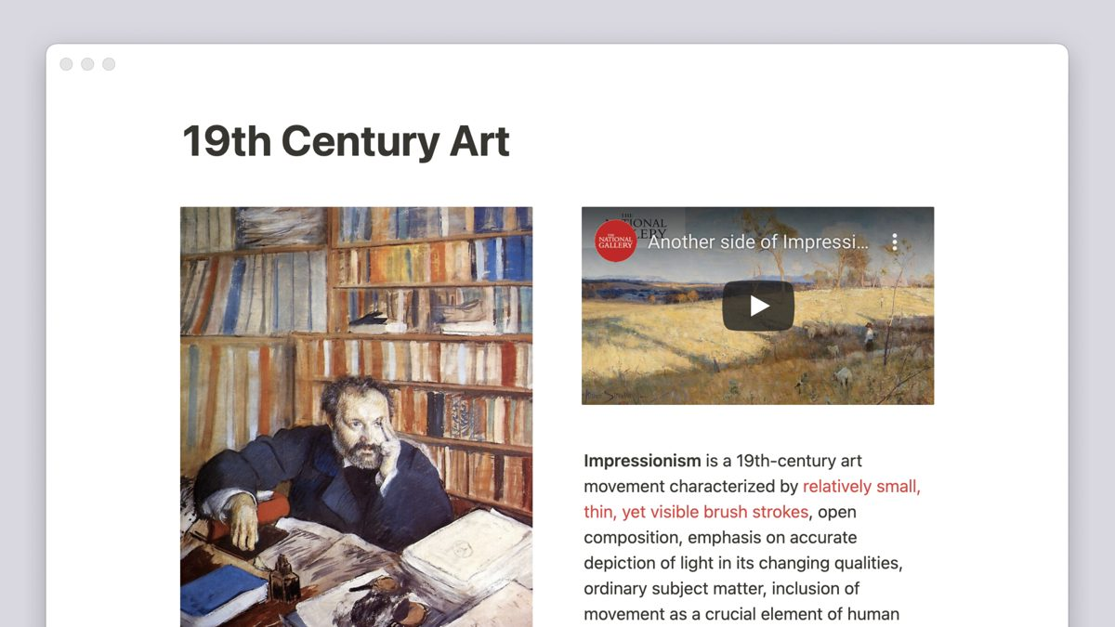
SHOW, DON'T TELL
Images, Files and Media
1
Upload or embed
Upload from your device, paste a URL, or pick from Unsplash and GIPHY.
2
Align, resize, caption
Hover controls set alignment and width; captions are styled text under the block.
3
Files and PDFs
/file embeds a downloadable file; PDFs preview inline; /video and /audio play in page.
4
Web bookmarks
Paste a link → Create bookmark for a card with title, description and preview image.
Mastering Notion for Content, Project, and Database Management · TGS-2023041080
© 2026 Tertiary Infotech Academy Pte Ltd
51

Slide 52
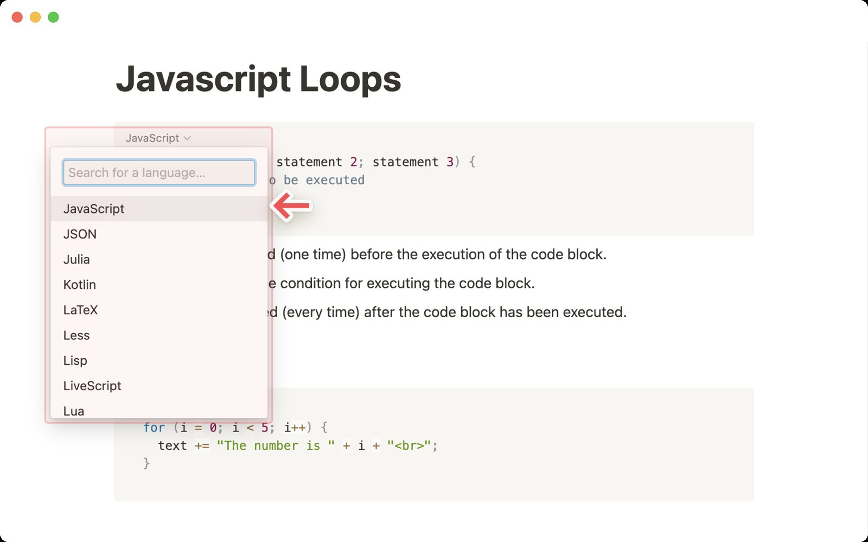
TECHNICAL CONTENT
Code Blocks and Buttons
1
Syntax highlighting
Choose from 60+ languages; toggle Wrap code; copy with one click; add a caption.
2
Buttons automate
/button → Insert blocks, Add page to, Edit pages in, Show confirmation, Open page.
3
Standard checklists
A button that inserts the article checklist keeps every editor on the same process.
4
Buttons in databases
Button properties run the same actions per row — approve, archive, log a review.
Mastering Notion for Content, Project, and Database Management · TGS-2023041080
© 2026 Tertiary Infotech Academy Pte Ltd
52

Slide 53
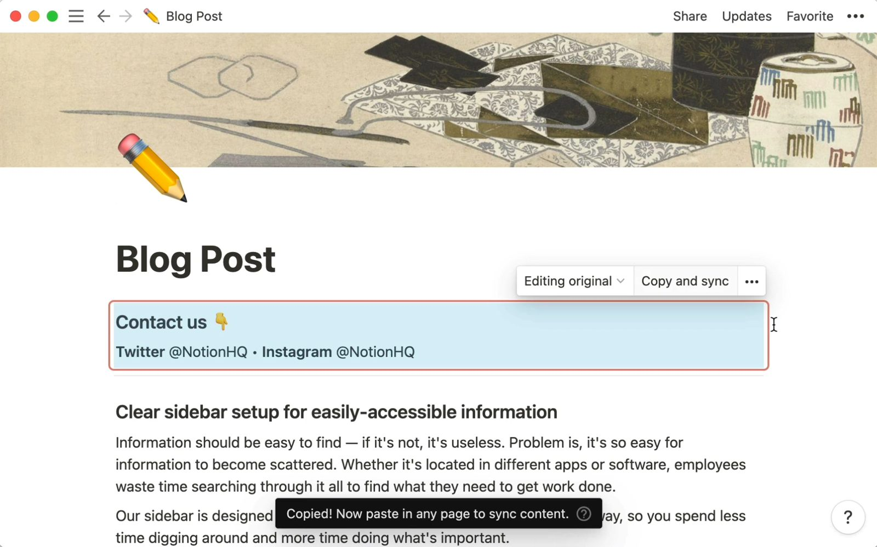
CONSISTENCY
Synced Blocks — Write Once, Update Everywhere
1
One source, many copies
Copy and sync a block to other pages; edits appear in every copy instantly.
2
Red outline
Synced blocks show a red border on hover with a count of pages using them.
3
Unsync when needed
⋯ → Unsync detaches a copy; Unsync all turns every copy into plain blocks.
4
Brightwave use
Brand footer, policy notice and contact block are synced across all public pages.
Mastering Notion for Content, Project, and Database Management · TGS-2023041080
© 2026 Tertiary Infotech Academy Pte Ltd
53

Slide 54
FROM DRAFT TO PUBLISHED
Posting Web Content — the Deployment Path
1
Draft
2
Enrich
3
Standardise
4
Review
5
Publish
Paste or write; structure with headings and blocks
Images, files, embeds, code and tables in context
Synced footer, button checklist, template
Comments, mentions, page history
Share settings or Publish to web, then track analytics
WHY IT MATTERS Deployment in a CMS means content is structured, reviewed and reachable — not merely typed.
Mastering Notion for Content, Project, and Database Management · TGS-2023041080
© 2026 Tertiary Infotech Academy Pte Ltd
54

Slide 55
TOPIC 03 · HANDS-ON LAB · FOUNDATION
Draft and Format a Blog Article with Blocks, Columns and Tables
LAB 04
K2 · A2
40 min
You post the supplied blog article draft into the Content Hub, structure it with headings, lists, toggles, quotes and dividers using slash commands and Markdown shortcuts, lay out a two-column comparison, and add a simple table from the facts sheet so the article is ready for deployment.
You will build
A fully structured blog article page in the Content Hub with headings, a table of contents, two columns and a facts table
Tools: Notion editor, Markdown shortcuts
ASSESSED K2 · A2
LEVEL Foundation
EVIDENCE Screenshots · lab README checklist
Mastering Notion for Content, Project, and Database Management · TGS-2023041080
© 2026 Tertiary Infotech Academy Pte Ltd
55

Slide 56
LAB 04 · WORKFLOW
How Lab 04 Runs
1
Prepare
2
Build
3
Refine
4
Verify
Post the draft
Structure with headings and lists
Lay out columns and a table
Polish with shortcuts
WHY IT MATTERS The shape of the work — the full click-by-click procedure is in the Learner Guide (Lab 04) and the lab's instruction PDF.
Mastering Notion for Content, Project, and Database Management · TGS-2023041080
© 2026 Tertiary Infotech Academy Pte Ltd
56

Slide 57
LAB 04 · ACCEPTANCE CHECK
Draft and Format a Blog Article with Blocks, Columns and Tables
✅ Acceptance check
The article page has a working table of contents, one Heading 1 and a Heading 2 per trend, a collapsed toggle, a quote block, an equal two-column section and a six-row simple table with a header row matching article-facts-table.csv.
IF IT DOES NOT WORK
1
Re-read the step: most misses are the page menu (top right) versus the block handle (left of a block).
2
Check you are in the right page or teamspace — the sidebar shows the path.
3
Full click-by-click steps: Learner Guide and the lab's instruction PDF.
Mastering Notion for Content, Project, and Database Management · TGS-2023041080
© 2026 Tertiary Infotech Academy Pte Ltd
57

Slide 58
TOPIC 03 · HANDS-ON LAB · INTERMEDIATE
Add Media, Code Blocks, Buttons and a Synced Brand Footer
LAB 05
K2 · A2
40 min
You enrich the article and the Content Hub with the supplied hero image and chart, an embedded PDF and video bookmark, a syntax-highlighted code sample, a button that inserts a standard 'article checklist', and a synced brand footer that appears on every article and updates from one place.
You will build
A media-rich article with captioned images, embeds, a code block, an insert-checklist button and a synced footer used on two pages
Tools: Notion media blocks, code blocks, buttons, synced blocks
ASSESSED K2 · A2
LEVEL Intermediate
EVIDENCE Screenshots · lab README checklist
Mastering Notion for Content, Project, and Database Management · TGS-2023041080
© 2026 Tertiary Infotech Academy Pte Ltd
58

Slide 59
LAB 05 · WORKFLOW
How Lab 05 Runs
1
Prepare
2
Build
3
Refine
4
Verify
Add and caption media
Embed files and links
Insert code and a button
Sync the brand footer
WHY IT MATTERS The shape of the work — the full click-by-click procedure is in the Learner Guide (Lab 05) and the lab's instruction PDF.
Mastering Notion for Content, Project, and Database Management · TGS-2023041080
© 2026 Tertiary Infotech Academy Pte Ltd
59

Slide 60
LAB 05 · ACCEPTANCE CHECK
Add Media, Code Blocks, Buttons and a Synced Brand Footer
✅ Acceptance check
The article shows a captioned full-width hero image, a centred chart, an embedded PDF, a web bookmark, a Python code block with wrap on, the Insert article checklist button inserts four to-dos, and the same synced footer appears on two pages and updates in both when edited.
IF IT DOES NOT WORK
1
Re-read the step: most misses are the page menu (top right) versus the block handle (left of a block).
2
Check you are in the right page or teamspace — the sidebar shows the path.
3
Full click-by-click steps: Learner Guide and the lab's instruction PDF.
Mastering Notion for Content, Project, and Database Management · TGS-2023041080
© 2026 Tertiary Infotech Academy Pte Ltd
60

Slide 61
04
TOPIC 04 · LU2 · A2 · K4
Advanced Content Techniques
Customising and styling content · links, backlinks and efficient navigation · math equations and diverse media types
Mastering Notion for Content, Project, and Database Management · TGS-2023041080
© 2026 Tertiary Infotech Academy Pte Ltd
61

Slide 62
TOPIC 04 · WHAT THIS TOPIC COVERS
Key Concepts — Advanced Content Techniques
Style with intent
Text colours, background colours, fonts (default, serif, mono), small text and full width are used per the style guide, not per mood.
Callouts, icons and covers
Callouts highlight warnings and tips; page icons and cover images make pages recognisable in the sidebar and in search.
1
2
Links and backlinks
Link inline with @ or [[; every link creates a backlink on the target page, so readers can navigate in both directions.
Navigation hubs
A home page with link-to-page blocks, a table of contents block and breadcrumbs gives readers one entry point to the whole space.
3
4
Math equations
KaTeX equations render as a block (/math) or inline ($$), for pricing formulas, KPIs and technical documentation.
Curation guidelines
A style guide, naming convention and review workflow turn individual pages into a consistent, trustworthy body of content.
5
6
Mastering Notion for Content, Project, and Database Management · TGS-2023041080
© 2026 Tertiary Infotech Academy Pte Ltd
62

Slide 63
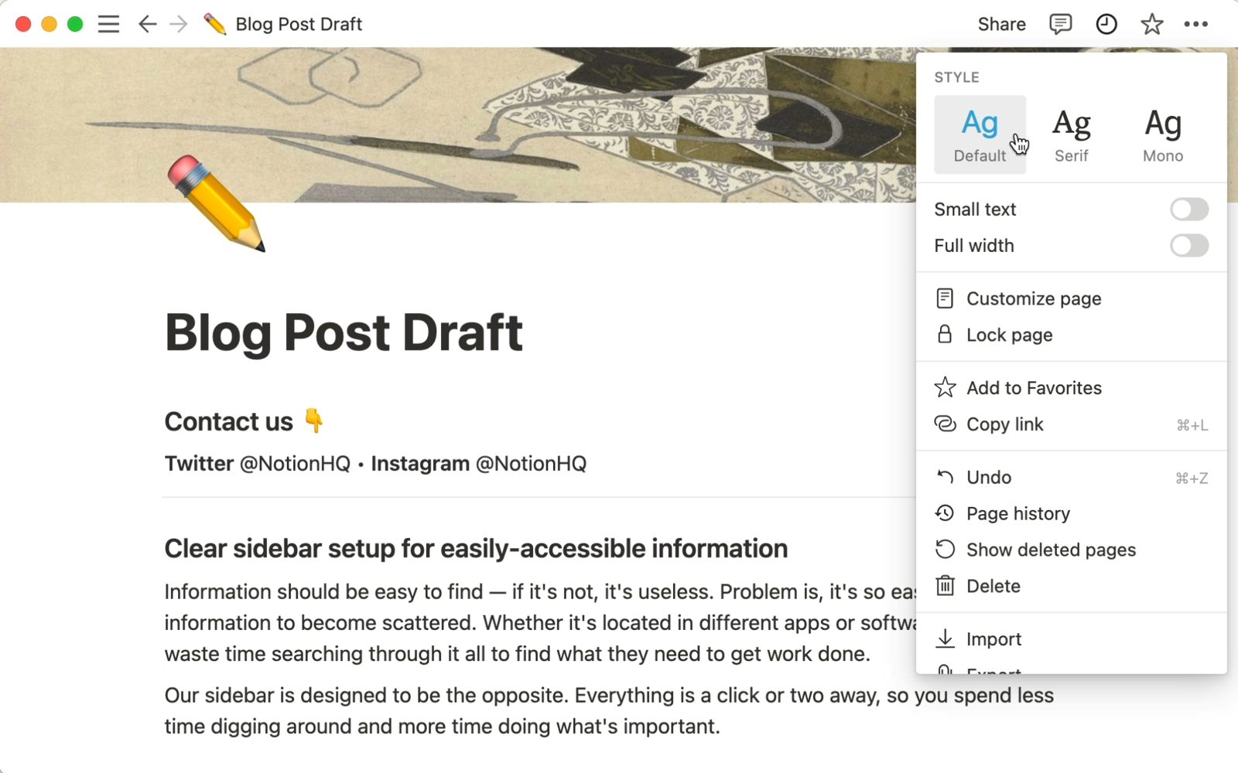
STYLE WITH INTENT
Customise and Style Your Content
1
Text and background colour
Nine colours each, from the toolbar A menu or ⋮⋮ → Colour; Cmd/Ctrl+Shift+H repeats the last.
2
Fonts and width
Default, Serif or Mono per page; Small text and Full width from the ⋯ menu.
3
Callouts
Icon + background for tips, warnings and policy notices — colour-coded by the style guide.
4
Icons and covers
Emoji, icon sets or uploads for icons; gallery, Unsplash or upload for covers.
Mastering Notion for Content, Project, and Database Management · TGS-2023041080
© 2026 Tertiary Infotech Academy Pte Ltd
63

Slide 64
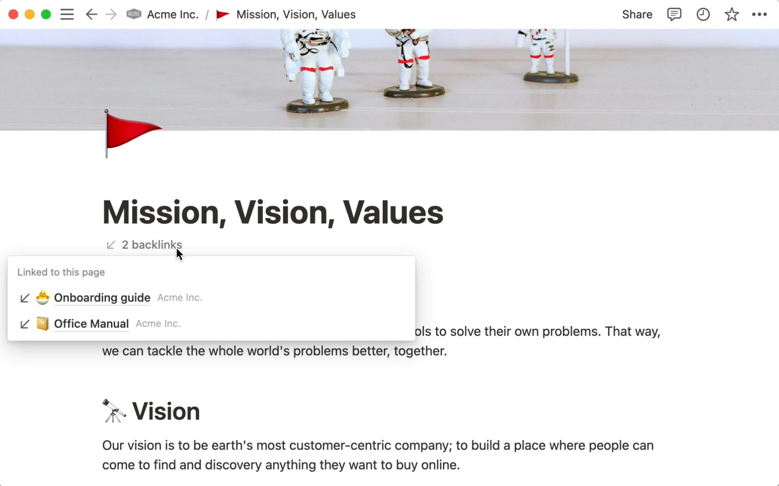
TWO-WAY NAVIGATION
Links and Backlinks
1
Inline links
@ mention, [[ link, or Cmd/Ctrl+K on selected text; paste a URL as link, bookmark, mention or embed.
2
Link to page block
A full-width block that shows the page title and icon — the building block of a hub.
3
Backlinks appear automatically
Every target page lists the pages that link to it, under the title.
4
Customise page
Show backlinks expanded, in a popover or off; show or hide comments and properties.
Mastering Notion for Content, Project, and Database Management · TGS-2023041080
© 2026 Tertiary Infotech Academy Pte Ltd
64

Slide 65
EFFICIENT NAVIGATION
Build a Navigation Hub
Start-here page
One home page per section with link-to-page blocks in reading order.
Table of contents
/table of contents on long pages; toggle headings for skimming.
1
2
Breadcrumb block
/breadcrumb shows the path on a page — useful on public sites without the sidebar.
Favorites and sidebar order
Pin the hub pages; keep section pages in a consistent order for every teamspace.
3
4
Two-click rule
Any published article is reachable in two clicks from the hub — measure it.
Backlinks as related reading
The backlinks list is a free 'related pages' panel — link generously.
5
6
Mastering Notion for Content, Project, and Database Management · TGS-2023041080
© 2026 Tertiary Infotech Academy Pte Ltd
65

Slide 66
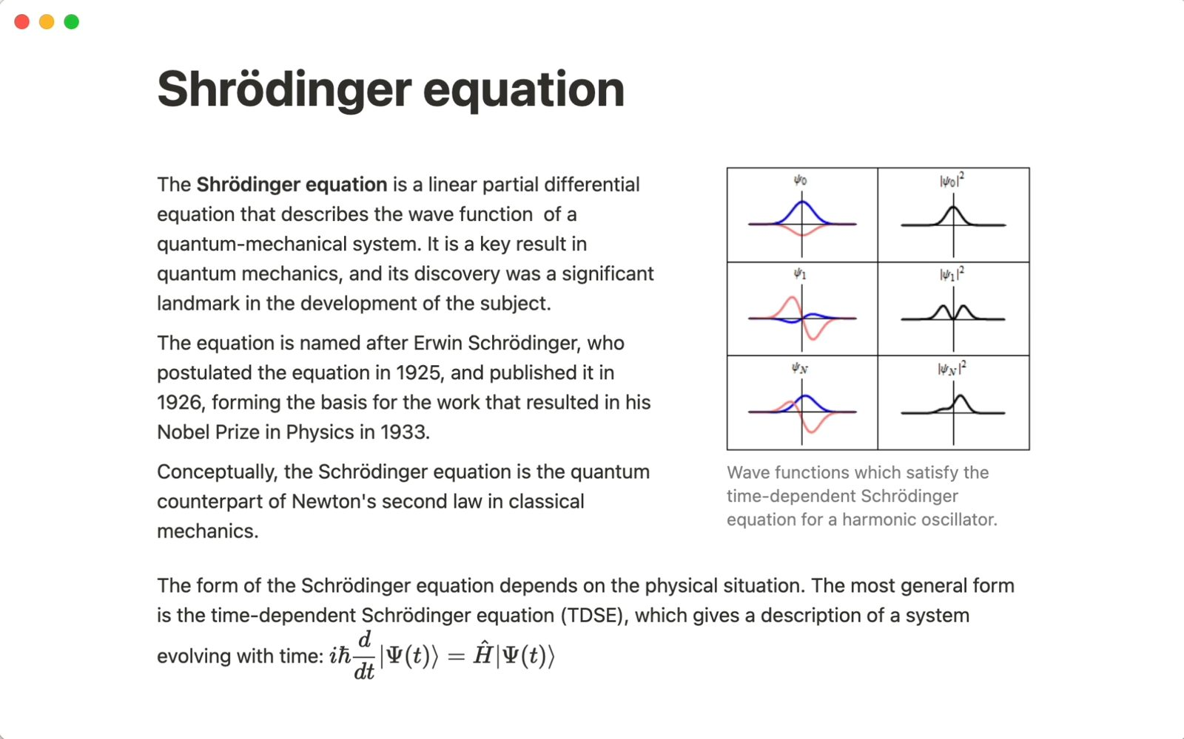
TECHNICAL NOTATION
Math Equations with KaTeX
1
Block equation
/math equation renders a centred LaTeX block — pricing formulas, KPI definitions.
2
Inline equation
Wrap in $$ … $$ inside a sentence; click to edit; supports fractions, Greek letters, sums.
3
Where it helps
Retainer pricing, ROI, engagement rate — documented once, referenced everywhere.
4
Beyond equations
Diverse media: video, audio, PDFs, Loom walkthroughs, Figma frames and Miro boards in the same page.
Mastering Notion for Content, Project, and Database Management · TGS-2023041080
© 2026 Tertiary Infotech Academy Pte Ltd
66

Slide 67
CREATION AND CURATION RULES
Content Curation Guidelines
Creating
Curating
• Creation rules
– Use the approved article template and the button checklist
– Titles follow the naming convention — Title Case, no dates, no abbreviations
– One idea per heading; headings build the table of contents
– Images captioned, files named, code blocks labelled with a language
– Colour and callouts only as the style guide defines them
• Curation rules
– Every page has an owner and a verification date
– Comments record decisions; resolved, never deleted
– Related pages linked both ways; hubs updated when pages move
– Stale pages archived to a dated section, not deleted — page history and trash are the backstop
– A quarterly review of the Verification view keeps the wiki trustworthy
RULE A style guide is a policy: publish it in the wiki, verify it, and link every template to it.
Mastering Notion for Content, Project, and Database Management · TGS-2023041080
© 2026 Tertiary Infotech Academy Pte Ltd
67

Slide 68
DECISION RULE
Should This Content Be a Page or a Database?
DATABASE
• Make it a database: each item becomes a page with properties
• Add views for each audience — board for editors, calendar for planning
• Templates give every new item the same structure
Will there be many similar items that need sorting, filtering or a calendar?
PAGE
• Keep it a page: rich, one-off content built from blocks
• Use headings, a table of contents and callouts for structure
• Link it from a hub and give it an owner
RULE Ten similar pages are a sign you need a database; ten different pages are a sign you need a hub.
Mastering Notion for Content, Project, and Database Management · TGS-2023041080
© 2026 Tertiary Infotech Academy Pte Ltd
68

Slide 69
TOPIC 04 · HANDS-ON LAB · INTERMEDIATE
Apply the Style Guide: Callouts, Links, Backlinks, Equations and a Navigation Hub
LAB 06
K4 · A2
45 min
You apply the supplied Brightwave style guide across the Content Hub — colours, fonts, callout conventions, icons and covers — build a navigation hub with link-to-page blocks and backlinks so every article is reachable in two clicks, and document the pricing formula with KaTeX equations.
You will build
A styled Content Hub with a navigation hub page, backlinks on every article, a style-compliant callout system and an equations page
Tools: Notion styling, links and backlinks, math equations, link-to-page blocks
ASSESSED K4 · A2
LEVEL Intermediate
EVIDENCE Screenshots · lab README checklist
Mastering Notion for Content, Project, and Database Management · TGS-2023041080
© 2026 Tertiary Infotech Academy Pte Ltd
69

Slide 70
LAB 06 · WORKFLOW
How Lab 06 Runs
1
Prepare
2
Build
3
Refine
4
Verify
Apply the style guide
Build the navigation hub
Link and check backlinks
Add math equations
WHY IT MATTERS The shape of the work — the full click-by-click procedure is in the Learner Guide (Lab 06) and the lab's instruction PDF.
Mastering Notion for Content, Project, and Database Management · TGS-2023041080
© 2026 Tertiary Infotech Academy Pte Ltd
70

Slide 71
LAB 06 · ACCEPTANCE CHECK
Apply the Style Guide: Callouts, Links, Backlinks, Equations and a Navigation Hub
✅ Acceptance check
Every article follows the style guide (default font, emoji icon, no cover, colour-coded callouts), Content Hub is a navigation hub with link-to-page blocks and a table of contents, Company Home's backlinks list the article, and Pricing Formulas renders a block and an inline KaTeX equation.
IF IT DOES NOT WORK
1
Re-read the step: most misses are the page menu (top right) versus the block handle (left of a block).
2
Check you are in the right page or teamspace — the sidebar shows the path.
3
Full click-by-click steps: Learner Guide and the lab's instruction PDF.
Mastering Notion for Content, Project, and Database Management · TGS-2023041080
© 2026 Tertiary Infotech Academy Pte Ltd
71

Slide 72
END OF DAY 1 · PM DIGITAL ATTENDANCE
Day 1 Recap — What You Can Now Do
Workspace and pages
Create a workspace, pages, sub-pages and blocks, and organise the sidebar (Lab 1).
Policies and wikis
Import policies, assign owners, verify pages and publish the content policy (Lab 2).
1
2
Collaboration
Review with comments, mentions, reminders, Inbox and search filters (Lab 3).
Rich content
Post and structure an article with blocks, columns and tables (Lab 4).
3
4
Media and reuse
Images, files, embeds, code blocks, buttons and synced blocks (Lab 5).
Curation
Apply a style guide, build a navigation hub, link and backlink, add equations (Lab 6).
5
6
Mastering Notion for Content, Project, and Database Management · TGS-2023041080
© 2026 Tertiary Infotech Academy Pte Ltd
72

Slide 73
End of Day 1
See you tomorrow at 9:30am — Databases, Publishing and Notion AI

Slide 74
05
TOPIC 05 · LU3 · A3 · K3
Database Essentials
Introduction to databases in Notion · properties and data sources · tasks, dependencies and linked databases · database views
Mastering Notion for Content, Project, and Database Management · TGS-2023041080
© 2026 Tertiary Infotech Academy Pte Ltd
74

Slide 75
TOPIC 05 · WHAT THIS TOPIC COVERS
Key Concepts — Database Essentials
A database is a set of pages
Every row, card or event is a full Notion page with properties on top and free content below. Full-page or inline, the data is the same.
Properties give structure
Title, text, number, select, multi-select, status, date, person, files, checkbox, URL, email, phone, formula, relation, rollup, created/edited time and ID.
1
2
Databases vs spreadsheets
There are no cell coordinates; each row has the same properties with its own values. That is why the same data can be shown as a board or calendar.
Views change the lens
Table, board, list, calendar, timeline, gallery, chart and form are layouts of one data source; each view keeps its own filters, sorts and groups.
3
4
Filters, sorts and groups
Simple filters target one property; advanced filters combine AND/OR groups. A filtered view also sets defaults on new rows (a forcing function).
Data sources and linked views
A linked view shows an existing data source in another page with its own views; sub-items and dependencies model task hierarchies and date shifting.
5
6
Mastering Notion for Content, Project, and Database Management · TGS-2023041080
© 2026 Tertiary Infotech Academy Pte Ltd
75

Slide 76
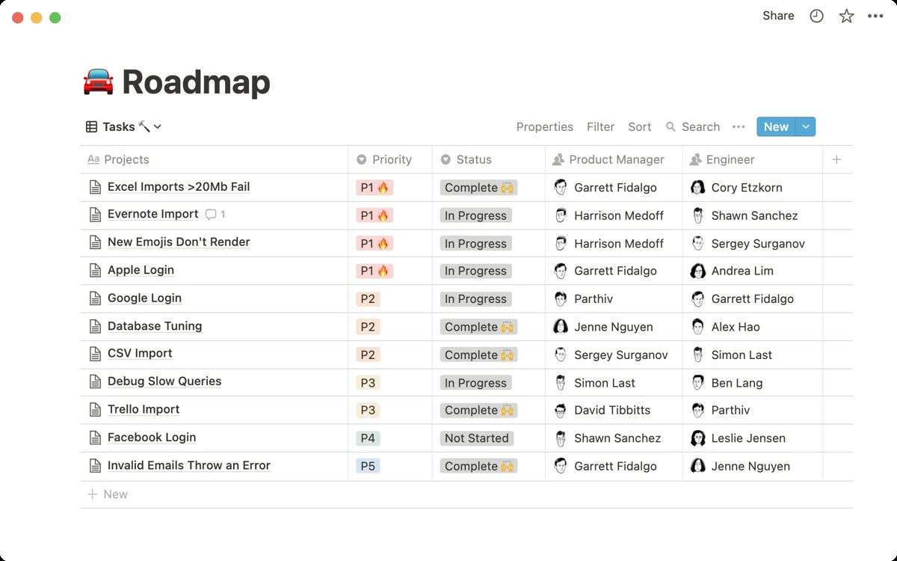
THE CORE IDEA
A Database Is a Collection of Pages
1
Every row is a page
Open any row, card or event: properties on top, unlimited content below.
2
Properties contextualise
Dates, status, people, links and files label every item consistently.
3
Many ways to view
The same data as table, board, list, calendar, timeline, gallery, chart or form.
4
Multiple data sources
One database can hold several data sources — contacts, companies and deals side by side.
Mastering Notion for Content, Project, and Database Management · TGS-2023041080
© 2026 Tertiary Infotech Academy Pte Ltd
76

Slide 77
WHY VIEWS ARE POSSIBLE
Databases Are Not Spreadsheets
Aspect
Spreadsheet
Notion database
Unit of data
A cell at coordinates B2
A row (page) with named properties
Formulas reference
Cells: =B2+D5
Properties: prop("Hours") * prop("Rate")
Layout
One grid
Table, board, calendar, timeline, gallery, list, chart, form
Rich content
Text in a cell
A whole page under every row
Relationships
VLOOKUP across sheets
Relations and rollups between databases
Filtering
Filter rows in place
Saved views with their own filters, sorts and groups
RULE The Name (Title) property cannot be deleted — it is the page title of every row.
Mastering Notion for Content, Project, and Database Management · TGS-2023041080
© 2026 Tertiary Infotech Academy Pte Ltd
77

Slide 78
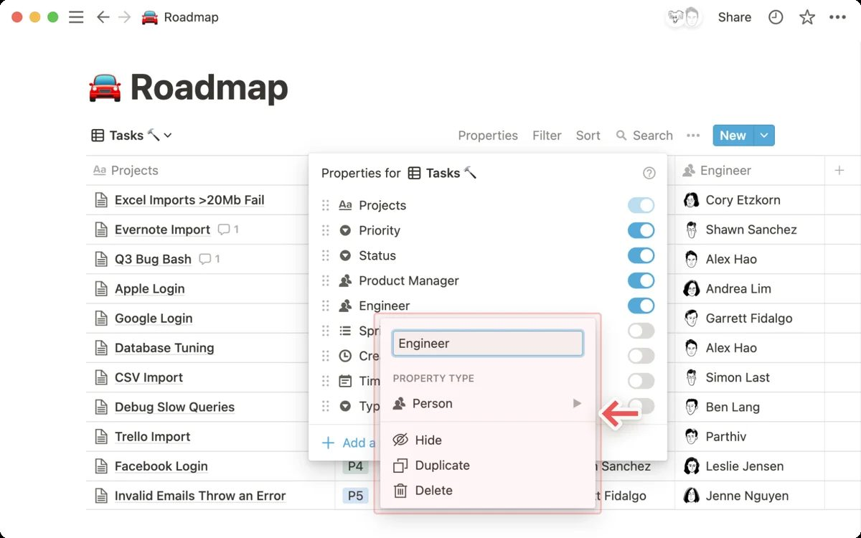
STRUCTURE
Database Properties
1
Writable types
Text, number, select, multi-select, status, date, person, files & media, checkbox, URL, email, phone, relation.
2
Computed types
Formula, rollup, created time/by, last edited time/by, ID, button, verification.
3
Manage in bulk
Edit property → type, name, options, number format; drag to reorder; hide per view; restore deleted.
4
Property defaults
Filtered views and templates pre-fill values on new rows — a forcing function.
Mastering Notion for Content, Project, and Database Management · TGS-2023041080
© 2026 Tertiary Infotech Academy Pte Ltd
78

Slide 79
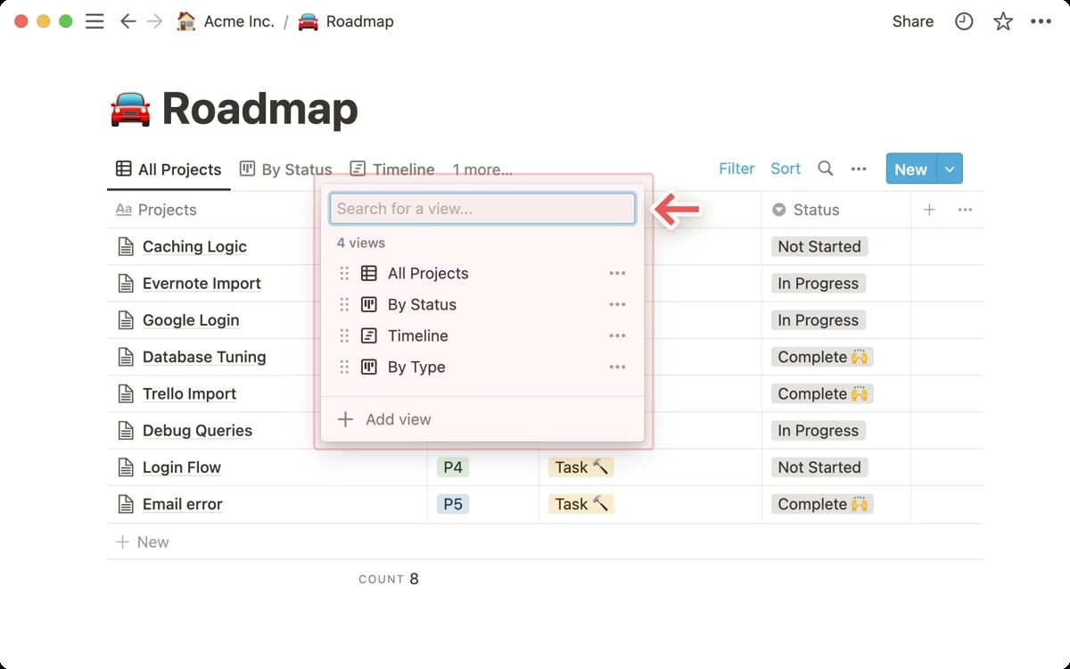
ONE SOURCE, MANY LENSES
Views, Filters, Sorts and Groups
1
Add a view
+ next to the tabs; each view has a layout, visible properties, filters, sorts, groups and a load limit.
2
Simple vs advanced filters
One property per simple filter; advanced filters mix AND / OR in nested groups.
3
Sorts and groups
Sort by several properties in order; group any layout (board columns, table sections).
4
Save for everyone
Changes to a shared view are personal until you click Save for everyone.
Mastering Notion for Content, Project, and Database Management · TGS-2023041080
© 2026 Tertiary Infotech Academy Pte Ltd
79

Slide 80
EIGHT LAYOUTS, ONE DATA SOURCE
Choosing a Layout
Layout
Best for
Grouped by
Brightwave use
Table
Editing many properties at once
Any property
Content Calendar master view
Board
Status flow (kanban)
Select / status / person
Editorial pipeline
Calendar
Dated items by day or week
Date property
Publishing schedule
Timeline
Dependencies and durations (Gantt)
Person / project
Client project plan
List
Simple, mobile-friendly lists
Any property
Policies index
Gallery
Visual items with covers
Any property
Design assets, portfolio
Chart
Bars, lines, donuts from properties
Any property
Metrics dashboard
Form
Collect responses as new rows
—
Client requests, feedback
Mastering Notion for Content, Project, and Database Management · TGS-2023041080
© 2026 Tertiary Infotech Academy Pte Ltd
80

Slide 81
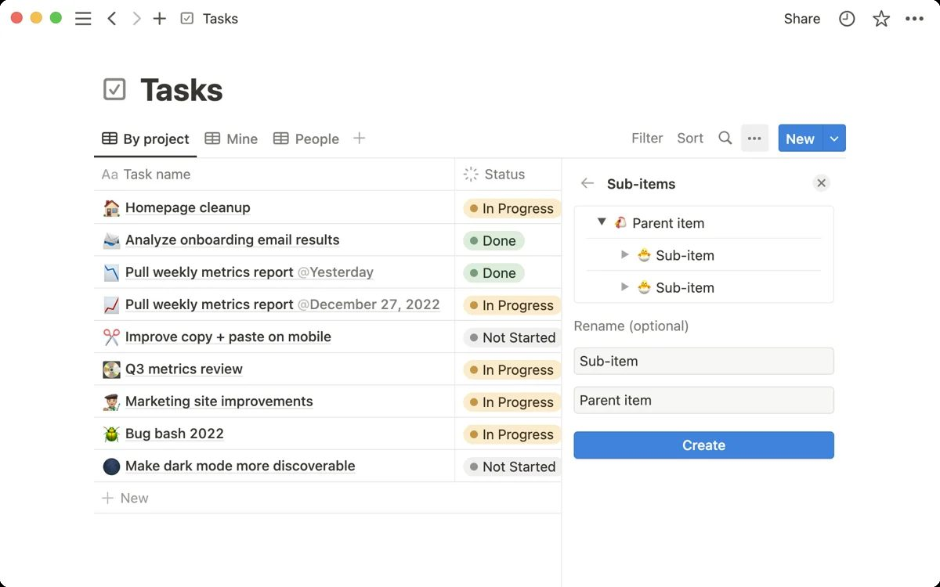
TASKS THAT KNOW EACH OTHER
Sub-items and Dependencies
1
Sub-items
Parent item / Sub-items properties turn a flat list into a hierarchy with a toggle per parent.
2
Dependencies
Blocked by / Blocking properties draw arrows on the timeline.
3
Date shifting
Choose whether moving a blocker shifts dependents always, only when dates overlap, or never.
4
Linked databases
/linked view shows a data source elsewhere with its own views — dashboards without duplication.
Mastering Notion for Content, Project, and Database Management · TGS-2023041080
© 2026 Tertiary Infotech Academy Pte Ltd
81

Slide 82
NATIVE CHART
Content Calendar by Status
WHAT THE DATA SHOWS
A donut of the 36 calendar items: 39% published, 17% scheduled, and a third still in draft or idea — the board view makes that backlog visible to every editor.
?
Native PowerPoint chart · editable data · indicative teaching figures
Mastering Notion for Content, Project, and Database Management · TGS-2023041080
© 2026 Tertiary Infotech Academy Pte Ltd
82

Slide 83
FIRST FIVE MOVES
Setting Up a New Database
1
Create
2
Add pages
3
Add properties
4
Add views
5
Edit views
New page → Table, or /database inline, or import a CSV
New row or card; each opens as a page
Status, date, person, select — the fields you will filter by
Board for flow, calendar for dates, gallery for visuals
Filter, sort, group, hide properties; Save for everyone
WHY IT MATTERS Build with AI can draft the properties and views from a one-sentence description — then you refine them.
Mastering Notion for Content, Project, and Database Management · TGS-2023041080
© 2026 Tertiary Infotech Academy Pte Ltd
83

Slide 84
TOPIC 05 · HANDS-ON LAB · FOUNDATION
Build the Content Calendar Database with Properties, Views and Filters
LAB 07
K3 · A3
30 min
You import the supplied content calendar CSV into a full-page database in the Content Hub, correct the property types, open rows as pages, add board, calendar and gallery views, and build filtered views for each editor so the team maintains every web asset from one source.
You will build
A Content Calendar database with typed properties, five views (table, board by status, calendar by publish date, gallery, 'My items'), filters, sorts and grouping
Tools: Notion databases (table, board, calendar, gallery views)
ASSESSED K3 · A3
LEVEL Foundation
EVIDENCE Screenshots · lab README checklist
Mastering Notion for Content, Project, and Database Management · TGS-2023041080
© 2026 Tertiary Infotech Academy Pte Ltd
84

Slide 85
LAB 07 · WORKFLOW
How Lab 07 Runs
1
Prepare
2
Build
3
Refine
4
Verify
Import the CSV as a database
Fix property types
Add board, calendar and gallery views
Filter, sort and group
WHY IT MATTERS The shape of the work — the full click-by-click procedure is in the Learner Guide (Lab 07) and the lab's instruction PDF.
Mastering Notion for Content, Project, and Database Management · TGS-2023041080
© 2026 Tertiary Infotech Academy Pte Ltd
85

Slide 86
LAB 07 · ACCEPTANCE CHECK
Build the Content Calendar Database with Properties, Views and Filters
✅ Acceptance check
Content Calendar contains every row from content-calendar.csv with the corrected property types, has table, board (grouped by Status, sub-grouped by Channel), calendar, gallery and My items views, the advanced filter returns only the matching rows, and the database is locked.
IF IT DOES NOT WORK
1
Re-read the step: most misses are the page menu (top right) versus the block handle (left of a block).
2
Check you are in the right page or teamspace — the sidebar shows the path.
3
Full click-by-click steps: Learner Guide and the lab's instruction PDF.
Mastering Notion for Content, Project, and Database Management · TGS-2023041080
© 2026 Tertiary Infotech Academy Pte Ltd
86

Slide 87
TOPIC 05 · HANDS-ON LAB · INTERMEDIATE
Manage Client Projects with Sub-tasks, Dependencies, Timeline and Linked Views
LAB 08
K3 · A3
30 min
You create the Projects and Tasks databases in Client Projects from the supplied CSVs, turn on sub-items and dependencies so date changes shift dependent tasks, plan the Nova Retail launch on a timeline, and embed linked views of the tasks inside each project page and on the Company Home dashboard.
You will build
Projects and Tasks databases with sub-tasks, dependencies and a timeline, plus linked task views inside project pages and on Company Home
Tools: Notion databases (timeline, sub-items, dependencies, linked views)
ASSESSED K3 · A3
LEVEL Intermediate
EVIDENCE Screenshots · lab README checklist
Mastering Notion for Content, Project, and Database Management · TGS-2023041080
© 2026 Tertiary Infotech Academy Pte Ltd
87

Slide 88
LAB 08 · WORKFLOW
How Lab 08 Runs
1
Prepare
2
Build
3
Refine
4
Verify
Create Projects and Tasks
Enable sub-items and dependencies
Plan on the timeline
Embed linked views
WHY IT MATTERS The shape of the work — the full click-by-click procedure is in the Learner Guide (Lab 08) and the lab's instruction PDF.
Mastering Notion for Content, Project, and Database Management · TGS-2023041080
© 2026 Tertiary Infotech Academy Pte Ltd
88

Slide 89
LAB 08 · ACCEPTANCE CHECK
Manage Client Projects with Sub-tasks, Dependencies, Timeline and Linked Views
✅ Acceptance check
Tasks has parent tasks with sub-items and dependency arrows on the timeline, moving a blocking task shifts its dependents, the Overdue view lists only late open tasks, the Nova Retail Launch page shows only its own tasks in a linked view, and Company Home shows locked linked views of Tasks and Content Calendar.
IF IT DOES NOT WORK
1
Re-read the step: most misses are the page menu (top right) versus the block handle (left of a block).
2
Check you are in the right page or teamspace — the sidebar shows the path.
3
Full click-by-click steps: Learner Guide and the lab's instruction PDF.
Mastering Notion for Content, Project, and Database Management · TGS-2023041080
© 2026 Tertiary Infotech Academy Pte Ltd
89

Slide 90
06
TOPIC 06 · LU3 · A4 · K7
Advanced Database Features
Relations, rollups and database templates · formula basics and syntax · database automations
Mastering Notion for Content, Project, and Database Management · TGS-2023041080
© 2026 Tertiary Infotech Academy Pte Ltd
90

Slide 91
TOPIC 06 · WHAT THIS TOPIC COVERS
Key Concepts — Advanced Database Features
Relations connect databases
A relation property links rows in the same or another database, optionally two-way, so a project knows its tasks and a task knows its project.
Rollups summarise relations
A rollup reads a property through a relation and aggregates it: count tasks, sum hours, show the earliest due date, percent complete.
1
2
Formulas compute
Formulas use properties, built-ins and functions (if, dateBetween, format, prop) to produce text, numbers, dates, booleans or lists.
Database templates
A template pre-fills page content and property defaults; set one as default per view so every new brief or ticket starts complete.
3
4
Automations act on triggers
When a property changes or a page is added, an automation can edit properties, add pages, send Slack messages or notify people.
Market awareness
Notion competes with Confluence, SharePoint, Coda, Airtable and Monday; know the plan tiers and where each tool fits to advise the organisation.
5
6
Mastering Notion for Content, Project, and Database Management · TGS-2023041080
© 2026 Tertiary Infotech Academy Pte Ltd
91

Slide 92
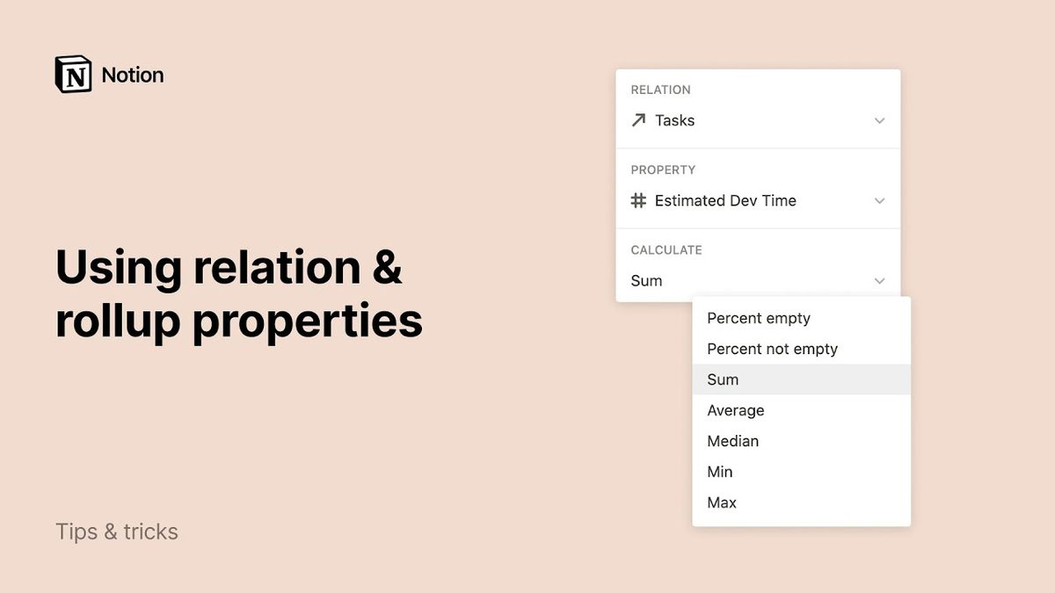
RELATIONAL MODEL
Relations Connect Databases
1
Same or different database
Relate Tasks to Projects, Projects to Clients, or a task to its parent task.
2
Two-way by default
Show on the related database creates the reciprocal property — edit either side.
3
Limit and display
Limit to one page for one-to-many; show as a property or hide in a view.
4
Brightwave model
Clients → Projects → Tasks and Deliverables — one source of truth for every client.
Mastering Notion for Content, Project, and Database Management · TGS-2023041080
© 2026 Tertiary Infotech Academy Pte Ltd
92

Slide 93
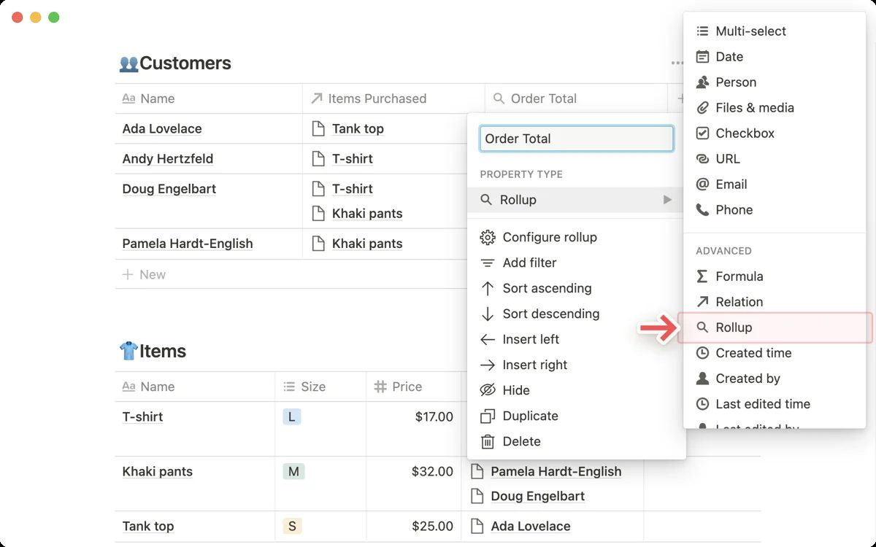
AGGREGATE
Rollups Summarise Related Rows
1
Read through a relation
Choose the relation, the property and the calculation.
2
Calculations
Count, count values, sum, average, min, max, earliest / latest date, percent checked or per group.
3
Show original
Show the related values themselves — a client sees its project names inline.
4
Examples
Total hours per project, % tasks done, next due date, total budget per client.
Mastering Notion for Content, Project, and Database Management · TGS-2023041080
© 2026 Tertiary Infotech Academy Pte Ltd
93

Slide 94
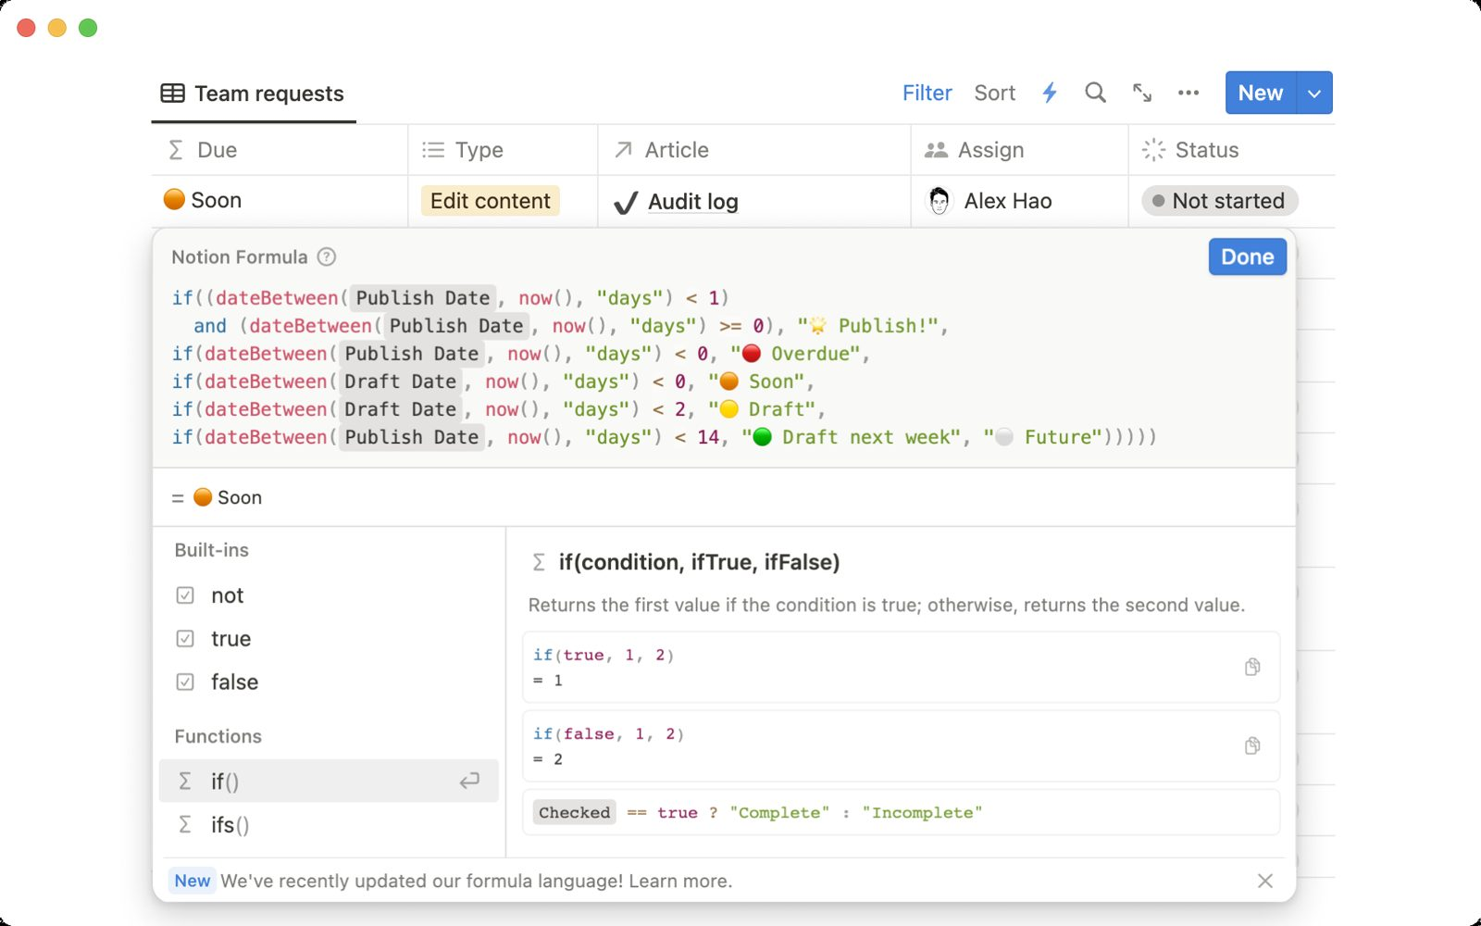
COMPUTE
Formula Basics and Syntax
1
Reference properties
prop("Name") reads a property; the editor autocompletes properties and functions.
2
Data types
Text, number, date, boolean, person, page and list — functions are typed, so convert with format() or toNumber().
3
Everyday functions
if, and, or, empty, dateBetween, dateAdd, now, format, round, concat, length, contains.
4
Read the docs
The formula reference lists every function with examples; test on one row first.
Mastering Notion for Content, Project, and Database Management · TGS-2023041080
© 2026 Tertiary Infotech Academy Pte Ltd
94

Slide 95
COPY, ADAPT, TEST
Formula Patterns Used in the Labs
Goal
Formula
Result type
Days left to a deadline
dateBetween(prop("Dates").end, now(), "days")
Number
Traffic-light health
if(prop("Tasks Done") >= 0.8, "🟢", if(prop("Days Left") < 7, "🔴", "🟡"))
Text
Budget per hour
format(round(prop("Budget (SGD)") / prop("Total Hours")))
Text
Priority score
prop("Impact") - prop("Effort")
Number
Overdue flag
and(prop("Due") < now(), prop("Status") != "Done")
Boolean
Minutes to text
format(round(prop("Avg Time (s)") / 60)) + " min"
Text
Mastering Notion for Content, Project, and Database Management · TGS-2023041080
© 2026 Tertiary Infotech Academy Pte Ltd
95

Slide 96
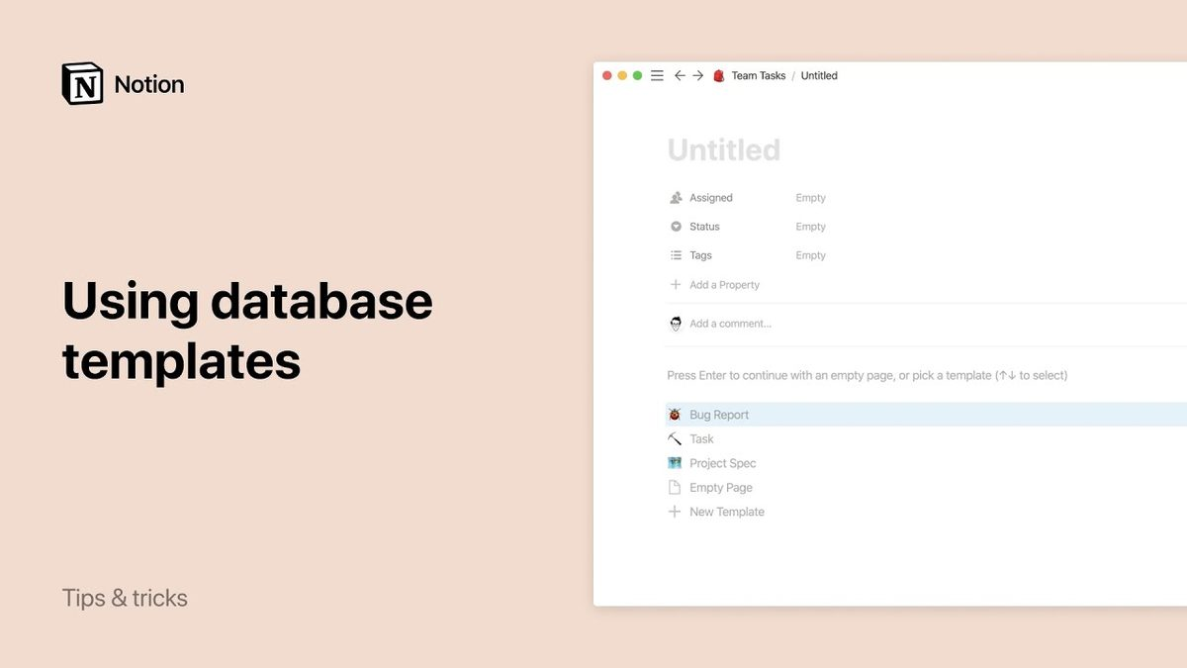
START COMPLETE
Database Templates
1
Create a template
New ▾ → New template: page content plus default property values.
2
Dynamic values
Date → Now or Today; Person → who duplicated the page.
3
Default per view
Set as default for this view or all views so every new row starts from it.
4
Nested databases
A template can contain a linked view filtered to the new page — a project brief with its own task list.
Mastering Notion for Content, Project, and Database Management · TGS-2023041080
© 2026 Tertiary Infotech Academy Pte Ltd
96

Slide 97
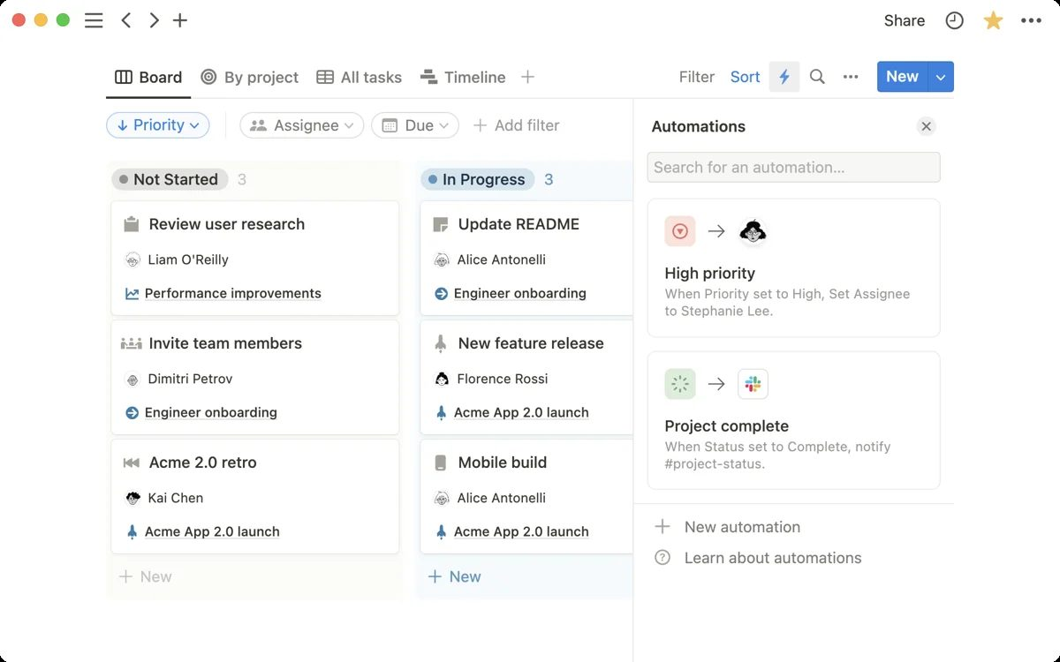
ACT ON TRIGGERS
Database Automations
1
Triggers
Page added; property edited (any or to a value); a button clicked; on a schedule.
2
Actions
Edit property, add a page, send Slack or Gmail notification, notify a person, send a webhook, define variables.
3
Buttons in pages
A /button can add a page, edit pages or open a page — a mini automation on demand.
4
Governance
Automations run as the creator; document them in the wiki and review quarterly.
Mastering Notion for Content, Project, and Database Management · TGS-2023041080
© 2026 Tertiary Infotech Academy Pte Ltd
97

Slide 98
KNOW THE FIELD
Market Awareness — Notion Versus Other CMS Offerings
Tool
Strength
Weakness for Brightwave
Fit
Notion
Docs + databases + wiki + publishing in one; AI built in
Limited offline; web publishing is simple, not a full site builder
Primary CMS
Confluence
Enterprise wiki, Jira integration
Weak databases; heavier admin
Not needed
Airtable
Powerful relational databases and interfaces
Thin documents and wiki
Overlap with Notion databases
Monday.com
Visual project boards and automations
Not a knowledge base
Overlap with Tasks
SharePoint
Microsoft 365 integration, governance
Complex; poor authoring experience
Only if M365-centric
WordPress
Full public websites, plug-in ecosystem
No internal wiki or task management
Public site at scale
RULE Evaluate on pricing tier, databases, wiki, permissions, API and publishing — then recommend, do not assume.
Mastering Notion for Content, Project, and Database Management · TGS-2023041080
© 2026 Tertiary Infotech Academy Pte Ltd
98

Slide 99
NATIVE CHART
Plan Tiers — What Each Adds
WHAT THE DATA SHOWS
Indicative tier comparison: page history grows from 7 days to a year and guest limits from 10 to 250. Notion AI, SAML SSO and private teamspaces arrive at Business; audit logs and SCIM at Enterprise. Always confirm current limits on notion.com/pricing.
?
Native PowerPoint chart · editable data · indicative teaching figures
Mastering Notion for Content, Project, and Database Management · TGS-2023041080
© 2026 Tertiary Infotech Academy Pte Ltd
99

Slide 100
TOPIC 06 · HANDS-ON LAB · ADVANCED
Connect Clients, Projects and Deliverables with Relations, Rollups, Formulas, Templates and Automations
LAB 09
K7 · A4
40 min
You create the Clients and Deliverables databases, relate Clients → Projects → Tasks and Deliverables, roll up hours, budgets and completion, write formulas for health status and days remaining, build a Project Brief template, add an automation that notifies the owner when a deliverable is approved, and complete a market comparison of Notion against Confluence, Airtable and Monday.
You will build
A relational model (Clients, Projects, Tasks, Deliverables) with rollups, formulas, a default project template, one automation and a CMS market comparison table
Tools: Notion relations, rollups, formulas, database templates, automations
ASSESSED K7 · A4
LEVEL Advanced
EVIDENCE Screenshots · lab README checklist
Mastering Notion for Content, Project, and Database Management · TGS-2023041080
© 2026 Tertiary Infotech Academy Pte Ltd
100

Slide 101
LAB 09 · WORKFLOW
How Lab 09 Runs
1
Prepare
2
Build
3
Refine
4
Verify
Create relations
Add rollups and formulas
Build templates and automations
Compare market offerings
WHY IT MATTERS The shape of the work — the full click-by-click procedure is in the Learner Guide (Lab 09) and the lab's instruction PDF.
Mastering Notion for Content, Project, and Database Management · TGS-2023041080
© 2026 Tertiary Infotech Academy Pte Ltd
101

Slide 102
LAB 09 · ACCEPTANCE CHECK
Connect Clients, Projects and Deliverables with Relations, Rollups, Formulas, Templates and Automations
✅ Acceptance check
Clients show Active Projects and Total Budget rollups, each project shows Total Hours, Tasks Done, Next Due, Days Left and a Health formula, new projects open with the Project Brief template, approving a deliverable sets Approved On and notifies the owner, and the Market Offerings table is complete for four tools.
IF IT DOES NOT WORK
1
Re-read the step: most misses are the page menu (top right) versus the block handle (left of a block).
2
Check you are in the right page or teamspace — the sidebar shows the path.
3
Full click-by-click steps: Learner Guide and the lab's instruction PDF.
Mastering Notion for Content, Project, and Database Management · TGS-2023041080
© 2026 Tertiary Infotech Academy Pte Ltd
102

Slide 103
Lunch Break
1 hour · back for PM digital attendance

Slide 104
07
TOPIC 07 · LU4 · A5 · K6
Collaboration and Publishing
Sharing, permissions and member management · collaborative activities · public pages and web publishing · page analytics
Mastering Notion for Content, Project, and Database Management · TGS-2023041080
© 2026 Tertiary Infotech Academy Pte Ltd
104

Slide 105
TOPIC 07 · WHAT THIS TOPIC COVERS
Key Concepts — Collaboration and Publishing
Permission levels
Full access, can edit, can edit content (databases only), can comment and can view; set per person, group, teamspace or the whole workspace.
Members, guests and groups
Members join the workspace; guests are invited to specific pages; groups make permissions repeatable. Owners manage security settings.
1
2
Teamspaces
Open, closed or private spaces with their own owners, members and default permissions — the unit of organisation for departments and clients.
Page lock and view lock
Lock a page to prevent accidental edits and lock database views so structure stays fixed while data can still change.
3
4
Publish to the web
Any page can become a public site with a notion.site URL, search-engine indexing, duplication and comment settings, and a public home page.
Page analytics
Every page shows views, unique visitors and viewers over time; workspace analytics adds member engagement, content and search behaviour.
5
6
Mastering Notion for Content, Project, and Database Management · TGS-2023041080
© 2026 Tertiary Infotech Academy Pte Ltd
105

Slide 106
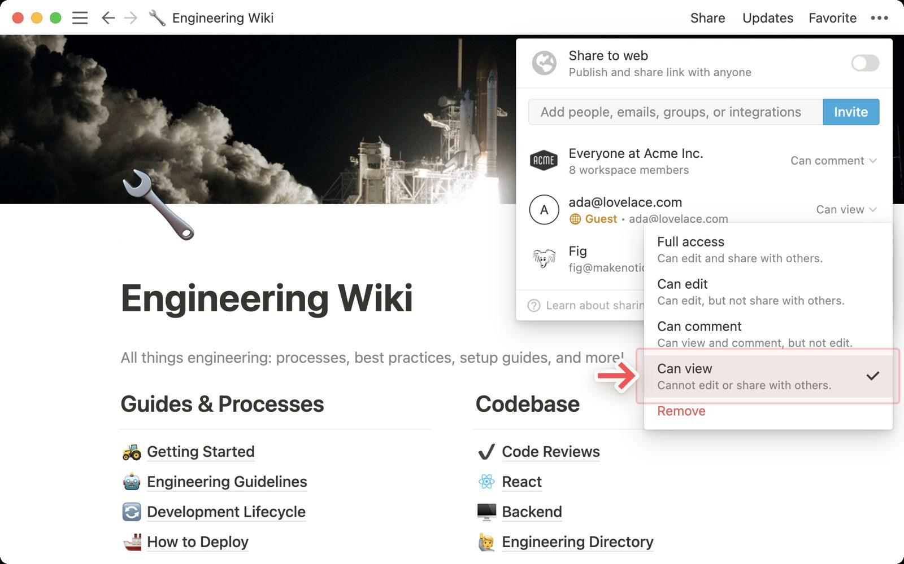
WHO CAN DO WHAT
Sharing and Permission Levels
1
Five levels
Full access · Can edit · Can edit content (databases) · Can comment · Can view.
2
Where they apply
Per person, per group, per teamspace and for the whole workspace; sub-pages inherit unless restricted.
3
Can edit content
Users add and edit rows but cannot change properties, views, filters or locks — perfect for guests.
4
See who has access
Share shows every person and group; Request access lets others ask.
Mastering Notion for Content, Project, and Database Management · TGS-2023041080
© 2026 Tertiary Infotech Academy Pte Ltd
106

Slide 107

MANAGE PEOPLE
Members, Guests and Groups
1
Members
Join the workspace by invite, link or allowed email domain; count toward billing.
2
Guests
Invited to specific pages only; free on most plans up to a limit; convert to members later.
3
Groups
Named sets of members (Editors, Designers) that carry permissions together.
4
Owners and admins
Workspace owners control security, billing and teamspaces; membership admins manage people.
Mastering Notion for Content, Project, and Database Management · TGS-2023041080
© 2026 Tertiary Infotech Academy Pte Ltd
107

Slide 108
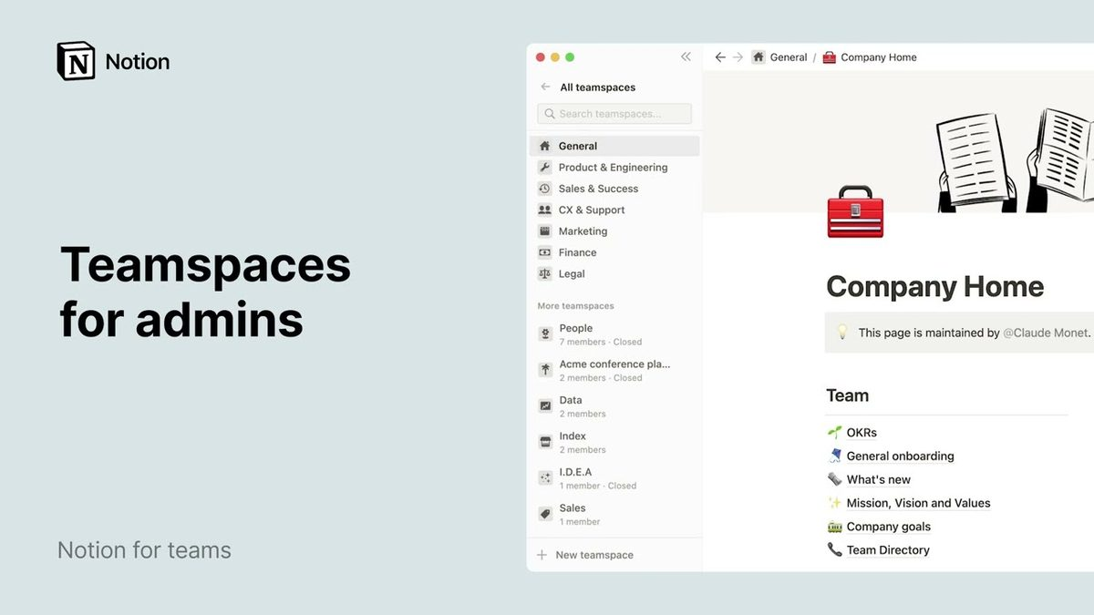
THE UNIT OF ORGANISATION
Teamspaces
1
Open, closed, private
Open: anyone can join; closed: visible but invite-only; private: hidden (Business and above).
2
Owners and members
Teamspace owners set default access, members, permissions and security settings.
3
Create or convert
+ next to Teamspaces, or turn an existing page into a teamspace.
4
Brightwave structure
Company (open) for the wiki and hub; Client Work (closed) for client projects with guests.
Mastering Notion for Content, Project, and Database Management · TGS-2023041080
© 2026 Tertiary Infotech Academy Pte Ltd
108

Slide 109
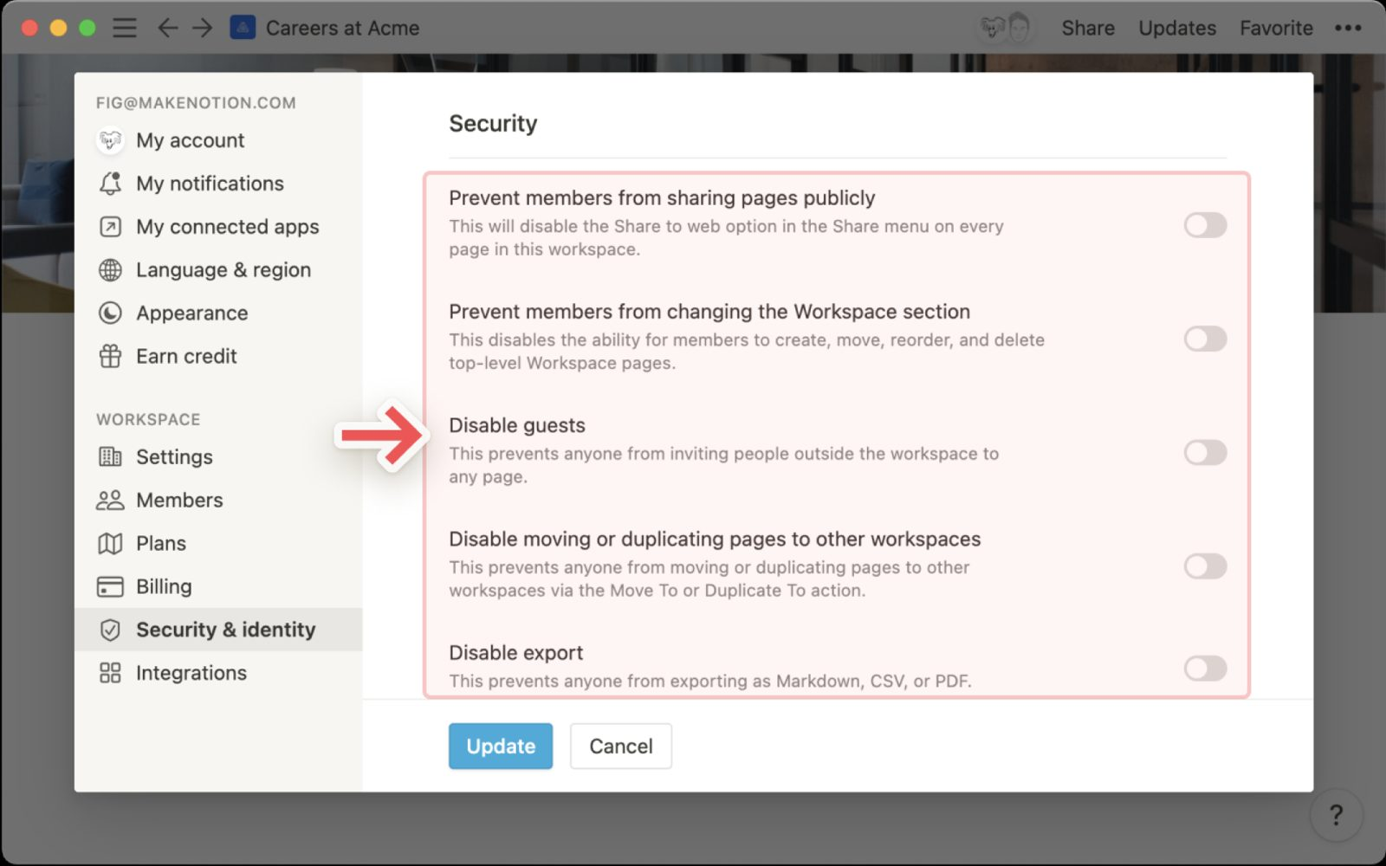
GOVERN
Security Settings and Page Lock
1
Workspace security
Disable public sharing, guests, export or duplication; allowed email domains; 2-step verification.
2
Page lock
⋯ → Lock page blocks edits; anyone with edit access can unlock — a safeguard, not a permission.
3
Lock database
Locks properties and views while data stays editable.
4
Enterprise controls
SAML SSO, SCIM provisioning, audit log, managed users, domain verification, HIPAA options.
Mastering Notion for Content, Project, and Database Management · TGS-2023041080
© 2026 Tertiary Infotech Academy Pte Ltd
109

Slide 110
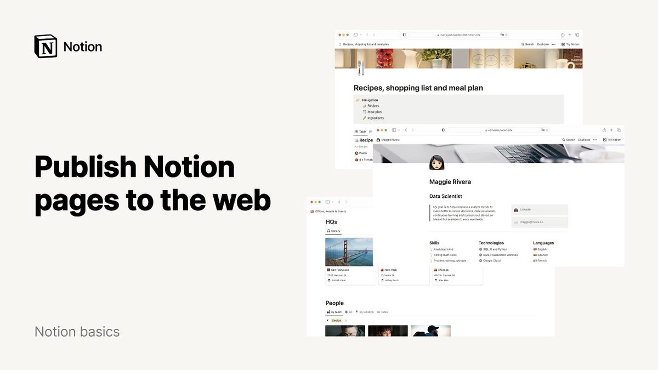
PUBLIC PAGES
Publish to the Web
1
One switch
Share → Publish → Publish to web gives a notion.site URL for the page and its sub-pages.
2
Options
Search engine indexing, allow duplicate as template, allow comments, link expiry (paid).
3
Sites
Set a public home page, custom domain (paid), navigation and a favicon under Settings → Sites.
4
Brightwave Help Centre
Published with indexing on and duplication off; private pages stay private.
Mastering Notion for Content, Project, and Database Management · TGS-2023041080
© 2026 Tertiary Infotech Academy Pte Ltd
110

Slide 111

MEASURE
Page Analytics
1
Per page
Views, unique visitors and the viewer list over 7, 30 or 90 days — from the page ⋯ menu.
2
Workspace analytics
Member engagement, content analysis (most viewed, stale pages) and search behaviour (paid plans).
3
Opting out
Workspace owners can disable analytics; individuals can hide their own views.
4
Beyond Notion
Public pages can be measured with Google Analytics via a custom domain and site settings.
Mastering Notion for Content, Project, and Database Management · TGS-2023041080
© 2026 Tertiary Infotech Academy Pte Ltd
111

Slide 112
TYPES OF METRICS
Performance Metrics for a Content Management System
Metric type
Examples
Where it comes from
Decision it informs
Reach
Page views, unique visitors, traffic by section
Page analytics, workspace analytics
What to promote or retire
Engagement
Time on page, comments, reactions, return visits
Analytics sample, comments
Which formats work
Freshness
Verified pages, pages past expiry, last edited age
Wiki verification view
Review priorities
Throughput
Items published per week, cycle time draft → published
Content Calendar rollups
Capacity planning
Quality
Broken links, missing owners, search with no result
Search behaviour, audits
Curation backlog
Satisfaction
Feedback sentiment, FAQ deflection, support tickets
Visitor Feedback database
Experience improvements
Mastering Notion for Content, Project, and Database Management · TGS-2023041080
© 2026 Tertiary Infotech Academy Pte Ltd
112

Slide 113
NATIVE CHART
Help Centre Views by Week
WHAT THE DATA SHOWS
Views more than doubled over twelve weeks after the Help Centre was published and indexed; unique visitors grew in step, so growth is new readers, not repeat traffic. The metrics dashboard in Lab 10 charts this from page-analytics-sample.csv.
?
Native PowerPoint chart · editable data · indicative teaching figures
Mastering Notion for Content, Project, and Database Management · TGS-2023041080
© 2026 Tertiary Infotech Academy Pte Ltd
113

Slide 114
TOPIC 07 · HANDS-ON LAB · INTERMEDIATE
Share, Set Permissions, Publish the Help Centre and Read Page Analytics
LAB 10
K6 · A5
25 min
You apply the supplied access matrix with members, guests, groups and teamspaces, lock the policy pages, publish the Help Centre to the web with search indexing and a public home page, then read page analytics and build a metrics dashboard from the supplied analytics sample so you can report on views, visitors and engagement.
You will build
A permission model matching the access matrix, a published Help Centre site, a page-analytics reading and a content metrics dashboard with a chart
Tools: Notion sharing, teamspaces, Publish to web, page analytics, chart view
ASSESSED K6 · A5
LEVEL Intermediate
EVIDENCE Screenshots · lab README checklist
Mastering Notion for Content, Project, and Database Management · TGS-2023041080
© 2026 Tertiary Infotech Academy Pte Ltd
114

Slide 115
LAB 10 · WORKFLOW
How Lab 10 Runs
1
Prepare
2
Build
3
Refine
4
Verify
Apply the access matrix
Create teamspaces and lock pages
Publish the Help Centre
Read and chart analytics
WHY IT MATTERS The shape of the work — the full click-by-click procedure is in the Learner Guide (Lab 10) and the lab's instruction PDF.
Mastering Notion for Content, Project, and Database Management · TGS-2023041080
© 2026 Tertiary Infotech Academy Pte Ltd
115

Slide 116
LAB 10 · ACCEPTANCE CHECK
Share, Set Permissions, Publish the Help Centre and Read Page Analytics
✅ Acceptance check
Sharing matches access-matrix.csv (member, guest, Editors group, closed Client Work teamspace), the policy page is locked, the Help Centre opens at a public notion.site URL with indexing on and duplication off, page analytics show views and unique visitors, and Content Metrics has two chart views and an Engagement formula.
IF IT DOES NOT WORK
1
Re-read the step: most misses are the page menu (top right) versus the block handle (left of a block).
2
Check you are in the right page or teamspace — the sidebar shows the path.
3
Full click-by-click steps: Learner Guide and the lab's instruction PDF.
Mastering Notion for Content, Project, and Database Management · TGS-2023041080
© 2026 Tertiary Infotech Academy Pte Ltd
116

Slide 117
08
TOPIC 08 · LU4 · A6 · K9
Data Management and Integrations
Importing data into Notion · embedding and connecting apps · the Notion API · exporting content and data integrity
Mastering Notion for Content, Project, and Database Management · TGS-2023041080
© 2026 Tertiary Infotech Academy Pte Ltd
117

Slide 118
TOPIC 08 · WHAT THIS TOPIC COVERS
Key Concepts — Data Management and Integrations
Import from anywhere
Import Confluence, Evernote, Trello, Asana, Google Docs, Word, Excel, CSV, Markdown and HTML; CSV becomes a database with typed properties.
Embeds
Paste a link to embed Google Drive, Maps, Figma, Loom, YouTube, PDFs, Typeform, GitHub gists and 1,900+ other sources inside a page.
1
2
Connections and link previews
Connect Slack, GitHub, Jira, Google Drive, Zoom and more; pasted links unfurl into live previews and synced databases mirror external issues.
The Notion API
An integration with a token calls api.notion.com to create pages, query data sources, update properties and search — the basis for Zapier, Make and custom plug-ins.
3
4
Data model in the API
A database object holds one or more data sources; each data source has a schema of properties and rows that are pages (API version 2025-09-03).
Export and integrity
Export a page or the whole workspace as PDF, HTML or Markdown + CSV; keep backups, page history and the trash policy in the content plan.
5
6
Mastering Notion for Content, Project, and Database Management · TGS-2023041080
© 2026 Tertiary Infotech Academy Pte Ltd
118

Slide 119
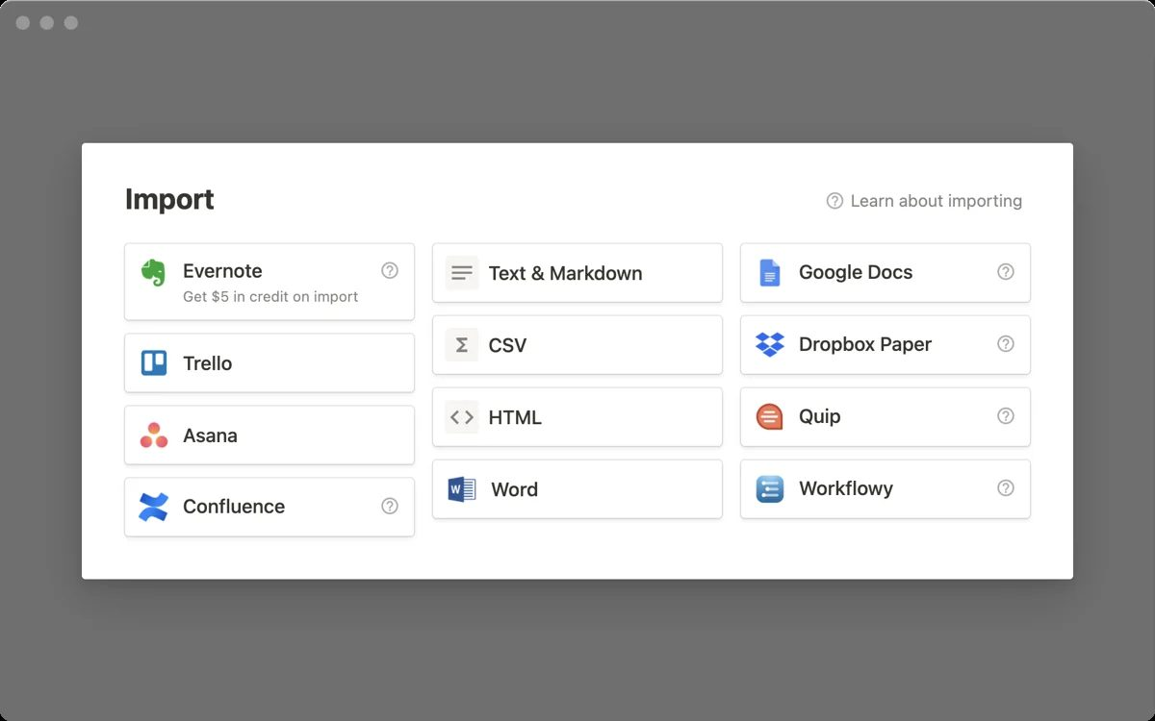
BRING IT IN
Import Data into Notion
1
Sources
Confluence, Evernote, Trello, Asana, Google Docs, Word, Excel, CSV, Markdown, HTML, Quip, Dropbox Paper.
2
CSV → database
Each column becomes a property; fix the types afterwards (Select, Date, Person).
3
Documents → pages
Word and Markdown become pages with headings and images preserved.
4
Migration plan
Import into a staging teamspace, clean up, then move into the final structure.
Mastering Notion for Content, Project, and Database Management · TGS-2023041080
© 2026 Tertiary Infotech Academy Pte Ltd
119

Slide 120
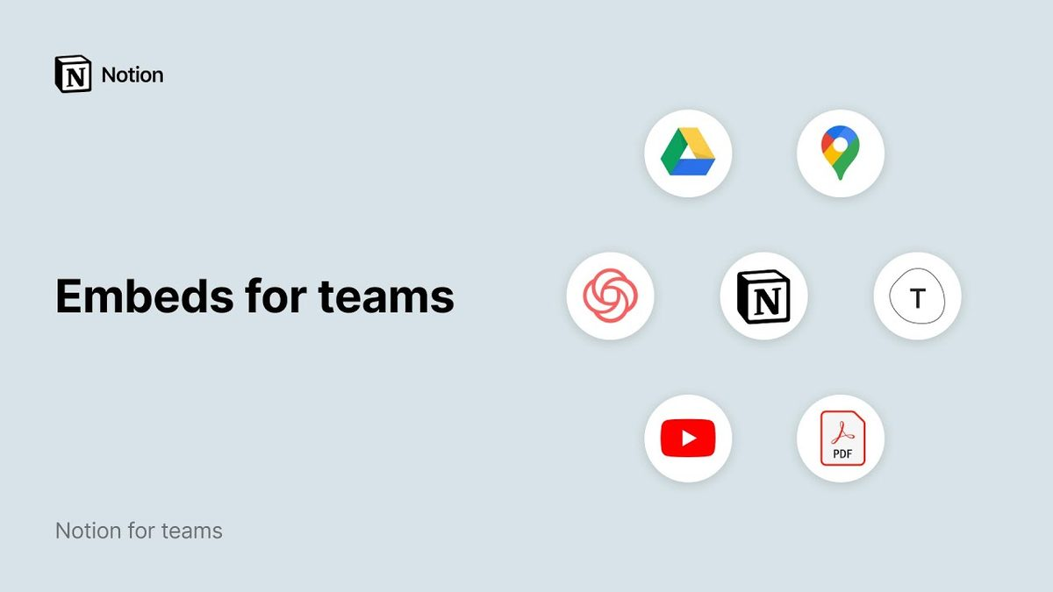
PLUG-INS AND EMBEDS
Embed and Connect Other Apps
1
1,900+ embeds
Paste a link → Embed for Google Drive, Maps, Figma, Loom, YouTube, PDFs, Typeform, Miro, GitHub gists.
2
Connections
Slack, GitHub, Jira, Asana, Google Drive, Zoom, Zendesk — authorised per user or per workspace.
3
Link previews and synced databases
Pasted links unfurl; Jira, GitHub and Asana boards can sync as live databases.
4
Marketplace
Zapier, Make, Super, Notion Calendar, Web Clipper and thousands of community tools extend Notion.
Mastering Notion for Content, Project, and Database Management · TGS-2023041080
© 2026 Tertiary Infotech Academy Pte Ltd
120

Slide 121
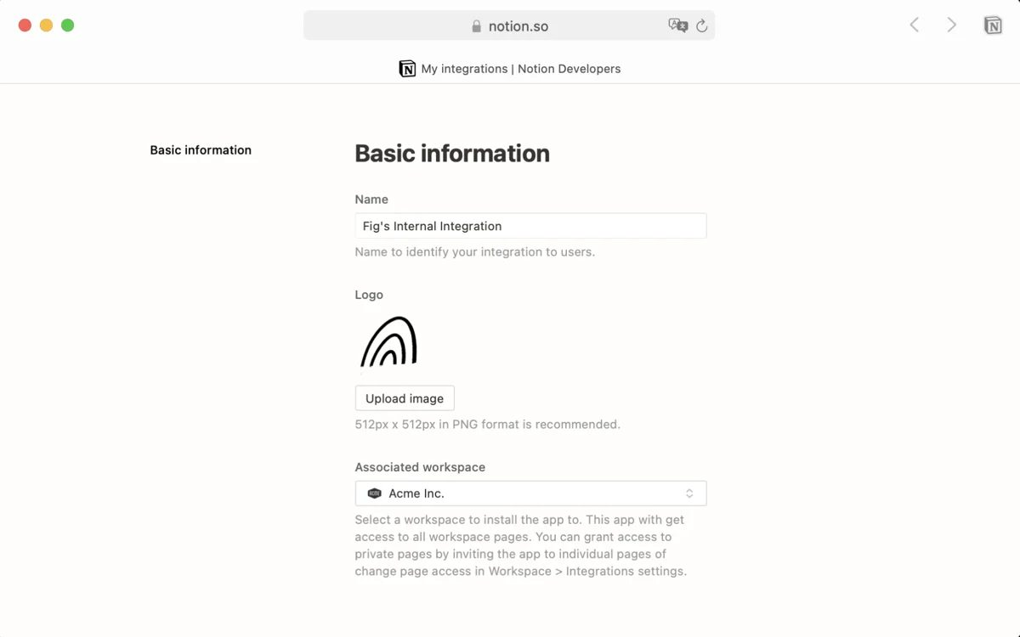
BUILD YOUR OWN PLUG-IN
The Notion API and Integrations
1
Create an integration
notion.so/profile/integrations → New; internal (your workspace) or public (OAuth).
2
Capabilities
Read, update, insert content; read comments; read user information — least privilege.
3
Connect to pages
A page or database must be connected to the integration before the API can see it.
4
Base URL and version
https://api.notion.com/v1 with a Notion-Version header (2025-09-03 introduces data sources).
Mastering Notion for Content, Project, and Database Management · TGS-2023041080
© 2026 Tertiary Infotech Academy Pte Ltd
121

Slide 122
OBJECTS YOU WILL MEET
The API Data Model (Version 2025-09-03)
Object
What it is
Key fields
Endpoint examples
Database
Container of one or more data sources; inline or full page
id, title, data_sources[], is_inline, public_url, in_trash
GET /databases/{id}
Data source
The schema (properties) and its rows
id, properties, parent database
GET /data_sources/{id}, POST /data_sources/{id}/query
Page
A row of a data source, or a standalone page
id, properties, parent, url
POST /pages, PATCH /pages/{id}
Block
Content inside a page
type, has_children
GET /blocks/{id}/children
User
Person or bot
id, type, name
GET /users
Search
Find pages and data sources shared with the integration
query, filter
POST /search
RULE Before 2025 a database had exactly one data source, so the two concepts were merged in the API — upgrade the version header to see the new shape.
Mastering Notion for Content, Project, and Database Management · TGS-2023041080
© 2026 Tertiary Infotech Academy Pte Ltd
122

Slide 123
QUERY, THEN CREATE
Calling the API from a Script
1
Token
2
Connect
3
Query
4
Create
5
Verify
Internal Integration Secret in .env — never in a page
Database ⋯ → Connections → your integration
POST /v1/data_sources/{id}/query with a filter body
POST /v1/pages with parent + properties
Refresh the database — the new row appears
WHY IT MATTERS Automation platforms (Zapier, Make, n8n) call the same endpoints — knowing them lets you evaluate any plug-in's claims.
Mastering Notion for Content, Project, and Database Management · TGS-2023041080
© 2026 Tertiary Infotech Academy Pte Ltd
123

Slide 124
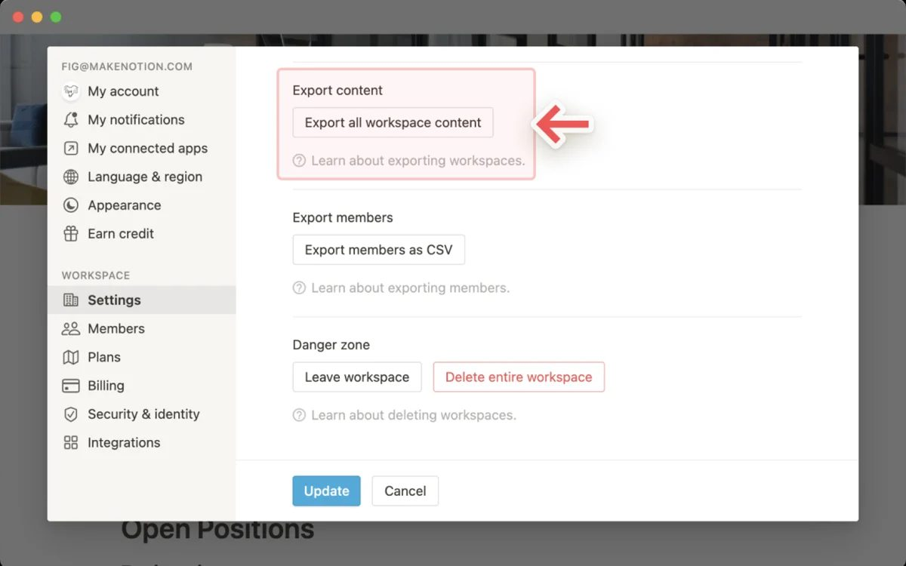
DATA INTEGRITY
Export Your Content
1
Per page
⋯ → Export as PDF, HTML or Markdown & CSV, with or without sub-pages.
2
Whole workspace
Settings → Export all workspace content (owners) — a ZIP with every database as CSV.
3
Backups and history
Notion keeps backups; page history and Trash (30 days) cover everyday mistakes.
4
Policy
Schedule a quarterly export, store it outside Notion, and record the date in the export checklist.
Mastering Notion for Content, Project, and Database Management · TGS-2023041080
© 2026 Tertiary Infotech Academy Pte Ltd
124

Slide 125
A6 · RECOMMEND WITH EVIDENCE
Recommending Plug-ins — Evaluation Criteria
Job to be done
Which content task does it remove or speed up? Name the workflow and the owner.
Data and permissions
What can it read or write? Prefer least-privilege capabilities and page-level connections.
1
2
Cost and plan
Free, per-user or per-task pricing, and whether it needs a Notion plan upgrade.
Maintenance
Who owns the connection, how are tokens rotated, what breaks when someone leaves?
3
4
Security and compliance
Vendor security page, data residency, SOC 2 — required for client data.
Exit path
Can you export and switch off without losing content? Avoid lock-in on core assets.
5
6
Mastering Notion for Content, Project, and Database Management · TGS-2023041080
© 2026 Tertiary Infotech Academy Pte Ltd
125

Slide 126
TOPIC 08 · HANDS-ON LAB · ADVANCED
Import, Embed, Connect Apps, Call the Notion API and Export
LAB 11
K9 · A6
25 min
You import a Trello-style board export, embed Google Drive, Figma and Loom links, connect Slack and GitHub, create an internal integration and use its token to query the Content Calendar and create a page through the Notion API, evaluate the supplied integration catalogue to recommend plug-ins for Brightwave, and export the workspace as Markdown + CSV.
You will build
An imported board, embedded assets, connected apps, a working API integration that reads and writes a database, a plug-in recommendation table and a workspace export
Tools: Notion Import, embeds, Connections, Notion API (integration token), Export
ASSESSED K9 · A6
LEVEL Advanced
EVIDENCE Screenshots · lab README checklist
Mastering Notion for Content, Project, and Database Management · TGS-2023041080
© 2026 Tertiary Infotech Academy Pte Ltd
126

Slide 127
LAB 11 · WORKFLOW
How Lab 11 Runs
1
Prepare
2
Build
3
Refine
4
Verify
Import and embed
Connect apps
Create and call an API integration
Recommend plug-ins and export
WHY IT MATTERS The shape of the work — the full click-by-click procedure is in the Learner Guide (Lab 11) and the lab's instruction PDF.
Mastering Notion for Content, Project, and Database Management · TGS-2023041080
© 2026 Tertiary Infotech Academy Pte Ltd
127

Slide 128
LAB 11 · ACCEPTANCE CHECK
Import, Embed, Connect Apps, Call the Notion API and Export
✅ Acceptance check
The Trello import shows as a board, the project page embeds three external assets, Slack and GitHub are connected, the API query prints the calendar rows and the API create call adds a Draft row, Recommended Integrations names three tools with justification, and a Markdown & CSV workspace export has been downloaded.
IF IT DOES NOT WORK
1
Re-read the step: most misses are the page menu (top right) versus the block handle (left of a block).
2
Check you are in the right page or teamspace — the sidebar shows the path.
3
Full click-by-click steps: Learner Guide and the lab's instruction PDF.
Mastering Notion for Content, Project, and Database Management · TGS-2023041080
© 2026 Tertiary Infotech Academy Pte Ltd
128

Slide 129
09
TOPIC 09 · LU4 · A7 · K8
Notion AI
What is Notion AI · Writer and Autofill · Q&A, Enterprise Search and the Notion Agent
Mastering Notion for Content, Project, and Database Management · TGS-2023041080
© 2026 Tertiary Infotech Academy Pte Ltd
129

Slide 130
TOPIC 09 · WHAT THIS TOPIC COVERS
Key Concepts — Notion AI
Your AI teammate inside Notion
Notion AI works in the pages, databases and connected apps you already use: it drafts, edits, summarises, translates, searches and builds.
Writer — draft and edit inline
Press Space on an empty line or highlight text: draft, continue writing, fix grammar, shorten, change tone, summarise, translate, brainstorm.
1
2
AI blocks
/AI block creates a block whose content is regenerated on demand — a living summary, key points or a custom output with specified context.
Autofill databases
An AI Autofill property fills summaries, keywords, translations or classifications for every row and can update as pages change.
3
4
Q&A, Enterprise Search and Research Mode
Ask questions across the workspace, Slack and Google Drive with citations; Research Mode produces reports on open-ended questions.
The Notion Agent and plans
The Agent takes on whole tasks (build a database, edit pages). Notion AI is included in Business and Enterprise; Free and Plus get trial responses.
5
6
Mastering Notion for Content, Project, and Database Management · TGS-2023041080
© 2026 Tertiary Infotech Academy Pte Ltd
130

Slide 131
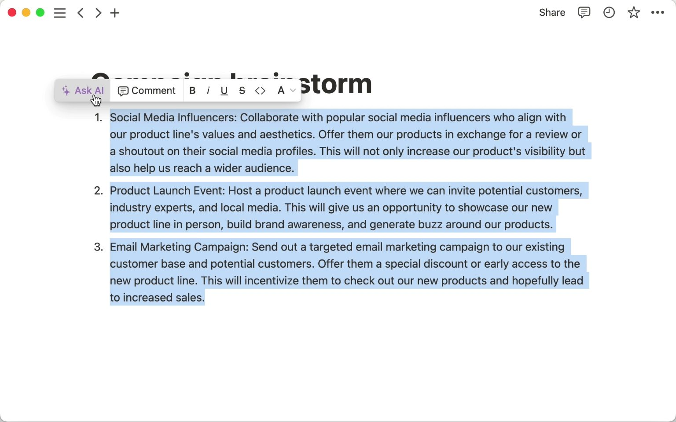
YOUR AI TEAMMATE
What Is Notion AI?
1
Built into the workspace
Works inside pages, databases and connected apps — no copy-paste to another tool.
2
What it does
Drafts and edits, summarises and translates, answers questions with citations, autofills databases, builds databases, transcribes meetings.
3
Models and data
Uses leading models (GPT and Claude families); customer data is not used to train them; encrypted in transit.
4
Availability
Included in Business and Enterprise; Free and Plus get complimentary trial responses.
Mastering Notion for Content, Project, and Database Management · TGS-2023041080
© 2026 Tertiary Infotech Academy Pte Ltd
131

Slide 132
NOTION AI · WRITER
Writer — Draft and Edit Inline
Draft from a prompt
Space on an empty line or /ai: outline, blog post, email, meeting agenda, job description.
Edit a selection
Improve writing, fix grammar, make shorter or longer, simplify, change tone, translate.
1
2
Continue and expand
Continue writing, explain this, find action items, summarise the page.
Review before accepting
Accept, discard or try again — the writer is responsible for the published text.
3
4
@-mention context
Mention pages or people in the prompt so the draft uses your workspace, not only world knowledge.
Translate whole pages
⋯ → Translate keeps the structure and produces a copy in the target language.
5
6
Mastering Notion for Content, Project, and Database Management · TGS-2023041080
© 2026 Tertiary Infotech Academy Pte Ltd
132

Slide 133
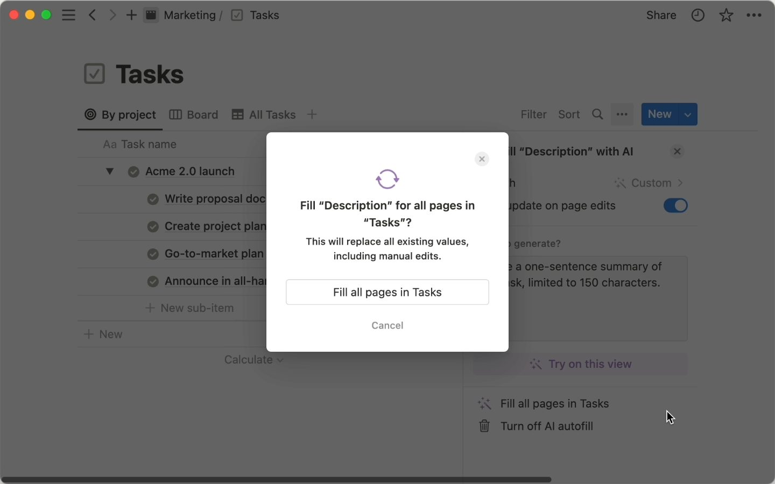
NOTION AI · AUTOFILL
Autofill Databases with AI
1
AI properties
AI Summary, AI Key info, AI Translation, AI Custom autofill and AI-generated select values.
2
Fill every row
Update all fills existing rows; auto-update refreshes when the page changes.
3
Use cases
Sentiment of feedback, keywords of articles, one-line summaries of client briefs, status classification.
4
Formulas too
Ask AI to write or explain a formula in the formula editor.
Mastering Notion for Content, Project, and Database Management · TGS-2023041080
© 2026 Tertiary Infotech Academy Pte Ltd
133

Slide 134
NOTION AI · ANSWERS AND ACTIONS
Q&A, Enterprise Search, Research Mode and the Agent
Capability
What you ask
Where it looks
Output
Q&A / chat
'What does the policy say about expiry?'
Workspace pages you can access
Answer with citations
Enterprise Search
'What was decided on the launch date?'
Notion + Slack, Google Drive, GitHub connectors
Answer across apps
Research Mode
'Report on our Q3 content performance'
Workspace + web
Structured report
Notion Agent
'Build a task database for the campaign'
Workspace + connected apps
Creates and edits pages and databases
Custom Agents
Scheduled or triggered work, e.g. weekly updates
Workspace + apps
Runs autonomously (credits)
AI Meeting Notes
Transcribe this meeting
Audio
Transcript, summary, action items
RULE Notion AI only shows information the asking user already has permission to see.
Mastering Notion for Content, Project, and Database Management · TGS-2023041080
© 2026 Tertiary Infotech Academy Pte Ltd
134

Slide 135
FROM SENTENCE TO SYSTEM
Build a Database with AI
1
Describe
2
Review
3
Accept
4
Populate
5
Refine
New page → Database → Build with AI; state purpose, properties, views
AI proposes properties and views; add, remove, rename
Click Done — an empty, structured database
Add rows, import a CSV, or autofill properties
Filters, templates, relations and automations as in Topics 5–6
WHY IT MATTERS AI drafts the structure; the content manager still owns the model — check every property type before the team starts entering data.
Mastering Notion for Content, Project, and Database Management · TGS-2023041080
© 2026 Tertiary Infotech Academy Pte Ltd
135

Slide 136
A7 · GENERATE IDEAS
Ideas That Improve the Visitor Experience
Listen first
Autofill sentiment and key issue on visitor feedback; group by issue to see what hurts most.
Answer faster
An AI-built FAQ database published in the Help Centre deflects repeat questions.
1
2
Guide the visitor
A start-here page, breadcrumbs, table of contents and two-click navigation.
Keep it current
Verification expiry plus a Content Metrics chart of stale, low-view pages.
3
4
Speak their language
Translate key pages; keep terminology consistent with a glossary.
Prioritise transparently
Impact minus effort ranks ideas; publish the plan and the roadmap.
5
6
Mastering Notion for Content, Project, and Database Management · TGS-2023041080
© 2026 Tertiary Infotech Academy Pte Ltd
136

Slide 137
GOVERNANCE
Notion AI Settings, Privacy and Plans
Setting or fact
Detail
Who controls it
AI Web Search
Enable web search; require confirmation for web requests
Workspace owner
Share data to improve Notion AI
Off by default — customer data is not used for training
Workspace owner
Model controls and usage
Choose allowed models; premium models spend Notion credits; per-member limits
Workspace owner / admin
AI Connectors
Slack, Google Drive, GitHub and others, subject to each user's permissions
Workspace owner
Security
TLS in transit; zero data retention for Enterprise, 30 days otherwise; SOC 2, ISO 27001, GDPR, HIPAA (Enterprise)
Notion
Pricing
Included in Business and Enterprise; trial responses on Free and Plus; Custom Agents use credits from May 2026
Plan
Mastering Notion for Content, Project, and Database Management · TGS-2023041080
© 2026 Tertiary Infotech Academy Pte Ltd
137

Slide 138
NATIVE CHART
Visitor Feedback Sentiment (Lab 12 Sample)
WHAT THE DATA SHOWS
Navigation and missing topics generate most negative feedback; content clarity is already positive. The improvement plan should start with the start-here page and the FAQ database, not with rewriting articles.
?
Native PowerPoint chart · editable data · indicative teaching figures
Mastering Notion for Content, Project, and Database Management · TGS-2023041080
© 2026 Tertiary Infotech Academy Pte Ltd
138

Slide 139
TOPIC 09 · HANDS-ON LAB · ADVANCED
Use Notion AI to Write, Autofill, Answer Questions and Improve the Visitor Experience
LAB 12
K8 · A7
25 min
You use Notion AI to draft and edit Help Centre articles, add an AI block summary, autofill keywords and sentiment on the supplied visitor feedback database, ask Q&A questions across the workspace, build a FAQ database with AI, and turn the answers into a prioritised list of visitor-experience improvements for the public Help Centre.
You will build
AI-drafted and edited Help Centre content, an autofilled feedback database, Q&A answers with citations, an AI-built FAQ database and a ranked visitor-experience improvement plan
Tools: Notion AI (Writer, AI blocks, Autofill, Q&A / Enterprise Search, Build with AI)
ASSESSED K8 · A7
LEVEL Advanced
EVIDENCE Screenshots · lab README checklist
Mastering Notion for Content, Project, and Database Management · TGS-2023041080
© 2026 Tertiary Infotech Academy Pte Ltd
139

Slide 140
LAB 12 · WORKFLOW
How Lab 12 Runs
1
Prepare
2
Build
3
Refine
4
Verify
Draft and edit with Writer
Autofill the feedback database
Ask Q&A and search
Rank improvement ideas
WHY IT MATTERS The shape of the work — the full click-by-click procedure is in the Learner Guide (Lab 12) and the lab's instruction PDF.
Mastering Notion for Content, Project, and Database Management · TGS-2023041080
© 2026 Tertiary Infotech Academy Pte Ltd
140

Slide 141
LAB 12 · ACCEPTANCE CHECK
Use Notion AI to Write, Autofill, Answer Questions and Improve the Visitor Experience
✅ Acceptance check
How to Request a Content Change was drafted with Writer and translated, the article carries two AI blocks, Visitor Feedback shows autofilled Sentiment and Key issue for every row, Q&A returns cited answers, the FAQ database was built with AI, and Visitor Experience Plan ranks ten improvements by the Priority formula with a management recommendation.
IF IT DOES NOT WORK
1
Re-read the step: most misses are the page menu (top right) versus the block handle (left of a block).
2
Check you are in the right page or teamspace — the sidebar shows the path.
3
Full click-by-click steps: Learner Guide and the lab's instruction PDF.
Mastering Notion for Content, Project, and Database Management · TGS-2023041080
© 2026 Tertiary Infotech Academy Pte Ltd
141

Slide 142
WRAP-UP
Course Summary & Next Steps
Mastering Notion for Content, Project, and Database Management · TGS-2023041080
© 2026 Tertiary Infotech Academy Pte Ltd
142

Slide 143
LEARNING OUTCOMES DELIVERED
What You Achieved
1
LO1 · Policies and permissions
A governed workspace: wiki, verified pages, owners, permissions, teamspaces and locks (Labs 1–3, 10).
2
LO2 · Post and update content
Structured, media-rich, style-compliant articles with navigation and synced components (Labs 4–6).
3
LO3 · Maintain web properties and assets
Relational databases for calendar, projects, tasks, clients and deliverables, with views, rollups, formulas and automations (Labs 7–9).
4
LO4 · Report, recommend, improve
Page analytics and a metrics dashboard, API-backed integrations and plug-in recommendations, and AI-generated visitor-experience ideas (Labs 10–12).
Mastering Notion for Content, Project, and Database Management · TGS-2023041080
© 2026 Tertiary Infotech Academy Pte Ltd
143

Slide 144
NEXT STEPS
Taking This Back to Work
Start with the policy
Write the content management policy first; every structure decision follows from it.
Four sections, then databases
Wiki, content, projects, public — then turn repeated pages into databases.
1
2
Owners and verification
No page without an owner; no policy without an expiry date.
Measure before you redesign
Read page analytics for a month before changing the navigation.
3
4
Integrate deliberately
Recommend plug-ins against the six criteria; keep the API token out of pages.
Let AI draft, keep humans accountable
Writer, Autofill and Q&A speed the work; a named person approves what is published.
5
6
Mastering Notion for Content, Project, and Database Management · TGS-2023041080
© 2026 Tertiary Infotech Academy Pte Ltd
144

Slide 145
CONTINUE THE JOURNEY
Recommended Follow-On Courses
1
Search Engine Optimization (SEO) to Enhance Brand Awareness and Online Business
WSQ funded · Tertiary Infotech Academy
2
Building Professional Websites with WordPress
WSQ funded · Tertiary Infotech Academy
3
Building a Successful eCommerce Store with WooCommerce
WSQ funded · Tertiary Infotech Academy
4
Build Your Online Presence and Website with Wix for Beginners
WSQ funded · Tertiary Infotech Academy
5
Running a Successful eCommerce Store with Shopify
WSQ funded · Tertiary Infotech Academy
Mastering Notion for Content, Project, and Database Management · TGS-2023041080
© 2026 Tertiary Infotech Academy Pte Ltd
145

Slide 146
WE ARE HERE TO HELP
Support
Email
enquiry@tertiaryinfotech.com — questions during and after the class
Telephone
+65 6100 0613
1
2
Website
www.tertiarycourses.com.sg/wsq-mastering-notion-for-content-project-and-database-management.html
LMS / TMS
lms-tms.tertiaryinfotech.com — courseware, attendance, assessment and TRAQOM survey
3
4
Mastering Notion for Content, Project, and Database Management · TGS-2023041080
© 2026 Tertiary Infotech Academy Pte Ltd
146

Slide 147
WRAP-UP · FINAL ASSESSMENT
Final Assessment
Written Assessment (WA)
Practical Performance (PP)
Format
Short-answer questions (SAQ)
Scenario-based practical tasks in Notion
What it tests
Underpinning knowledge K1–K9
Practical abilities A1–A7
Items
9 questions
5 tasks
Duration
1 hour
1 hour
Conditions
Open book, individual
Open book, individual
Submission
On the LMS
On the LMS, with screenshots as evidence
RULE Open book: slides, Learner Guide and your own lab work. 75% attendance is required; an appeal process is available.
Mastering Notion for Content, Project, and Database Management · TGS-2023041080
© 2026 Tertiary Infotech Academy Pte Ltd
147

Slide 148
ON ASSESSMENT DAY
Assessment Flow
1
2
3
4
5
TRAQOM survey — scan the QR code on the LMS
Assessment digital attendance — scan the SSG QR
Sit WA (SAQ) then PP — open book
Submit your answers on the LMS
Sign the Assessment Summary Record
Submit both papers on the LMS, then sign the Assessment Summary Record with your assessor.
Mastering Notion for Content, Project, and Database Management · TGS-2023041080
© 2026 Tertiary Infotech Academy Pte Ltd
148

Slide 149
TRAQOM · SSG DIGITAL ATTENDANCE
Digital Attendance (Mandatory)
1
2
3
4
Trainer displays the SSG digital attendance QR code
Scan it with your phone camera (Singpass app)
Submit your attendance
Repeat for AM, PM and the assessment session
Attendance is taken digitally for every session of a WSQ-funded course; a minimum of 75% attendance is required for assessment and funding.
Mastering Notion for Content, Project, and Database Management · TGS-2023041080
© 2026 Tertiary Infotech Academy Pte Ltd
149

Slide 150
SEE YOU IN CLASS
Thank You!
You can now build, govern, publish and measure a complete content management system in Notion.
Mastering Notion for Content, Project, and Database Management · TGS-2023041080
© 2026 Tertiary Infotech Academy Pte Ltd
150

